Slide 1

Greenwashing vs Bluewashing

Slide 2
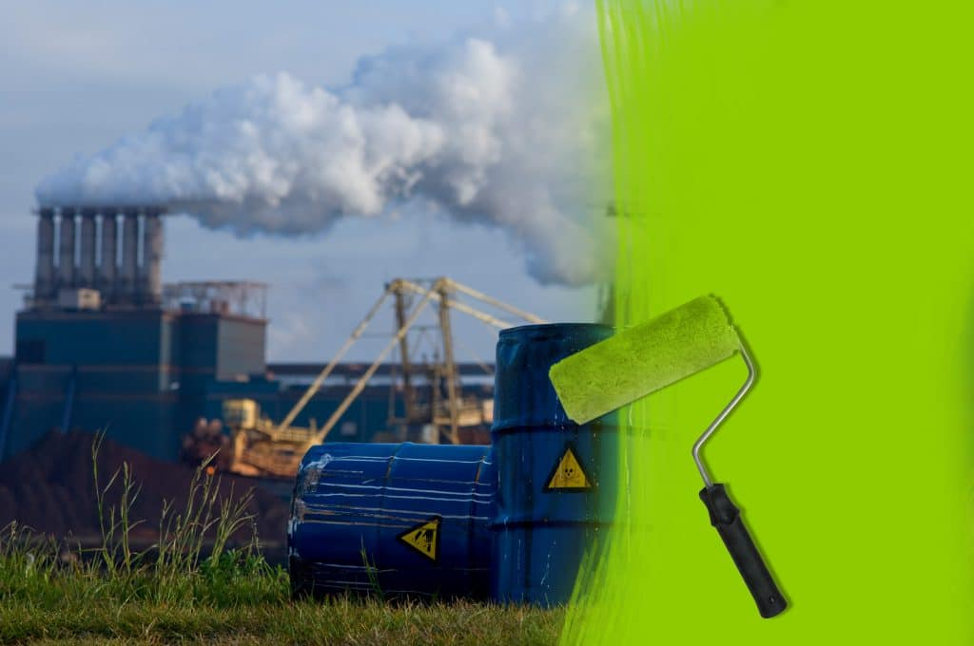
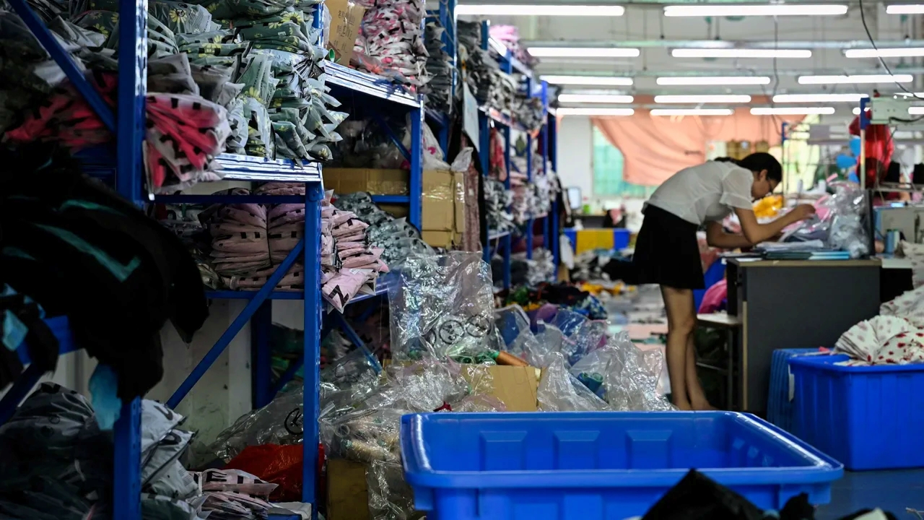
Difference between
Greenwashing
Bluewashing
Companies present themselves as more environmentally friendly than they actually are.
Companies that exaggerate their commitment to social responsibility, particularly human rights and ethical labour practices.

Slide 3
Common Elements
Both are forms of deception that mislead consumers and stakeholders
Prime intent is to improve a company’s public image
Both involve misleading marketing, vague claims or superficial changes that don’t impact workers or the environment very much.
Generallly there is a lot of overclaiming and overpromising but failing to deliver

Slide 4
Greenwashing
A company may claim its products are “eco-friendly” without evidence or may highlight a minor sustainable practice while ignoring larger harmful practices.
Eg a fuel company might promote renewable energy but continues to engage in environmentally damaging activities.
https://www.msn.com/en-us/money/markets/new-study-reveals-shady-practices-of-massive-oil-companies-decades-of-empty-words/ar-AA1QXHIw?ocid=socialshare

Slide 5
Bluewashing
A company might sign up to the UN Global Compact which promotes ethical business practices, incorporates a blue theme or the UN Global Compact symbol to indicate its support of ethical business practices but does not adopt or make changes to ensure human rights are protected with a slavery-free supply chain.
Eg a fashion store claiming their clothing are ethically sourced from recycled materials but at the same time support poor working conditions of the workers making the garments.
https://youtu.be/uU5DsHPa700

Slide 6
Why this is important.
Corporate behaviour must be ethical and lawful so as not to deceive customers, shareholders and the community at large.
Unethical behaviour can lead to lawsuits which can be costly to business not only in dollar terms but also reputational damage to corporate brands.
Improving environmental, social and governance can reduce risk by mitigating lawsuits, damage to the environment and increase economic conditions.
ASIC can enforce penalties against companies who greenwash or bluewash their statements that lead to false and misleading claims which is unlawful under the Trade Practices Act, ASIC Act 2001 and non-compliance with the Corporations Act 2001 related to disclosure processes for ‘sustainability-related products’.
The rush to a ‘clean energy’ transition can result in companies minimizing or deliberately overlooking human rights abuse creating a polluted bluewash supply chain.
Modern slavery can occur in industries that are meant to provide clean energy eg wind, solar and batter supply chains. The public may assume energy is clean, when infact their production sources support worker exploitation in less developed countries.
Exploitation and deception at any level weakens trust between external stakeholders (consumers, shareholders, communities) and the company.

