Slide 1
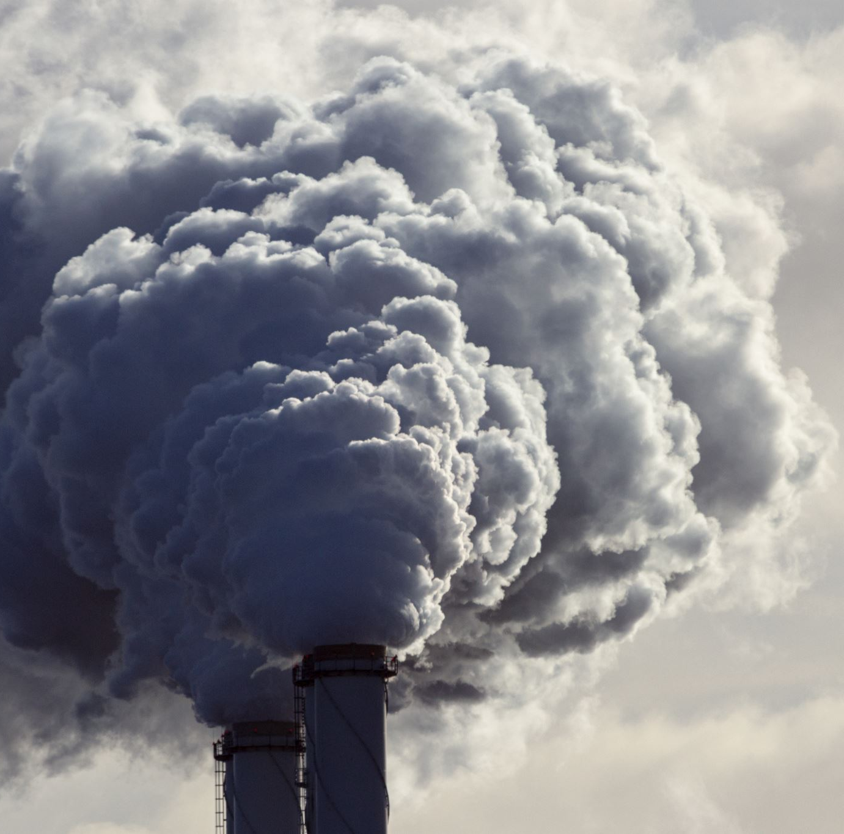
Greenhouse Gas Emissions
Scopes 1, 2 and 3

Slide 2
Why are there 3 Scopes of Emissions?
It’s a comprehensive framework that helps businesses
  a) assess their whole carbon footprint and
  b) embrace a more sustainable strategy of solutions to minimize or eliminate their carbon
  footprint.

Slide 3
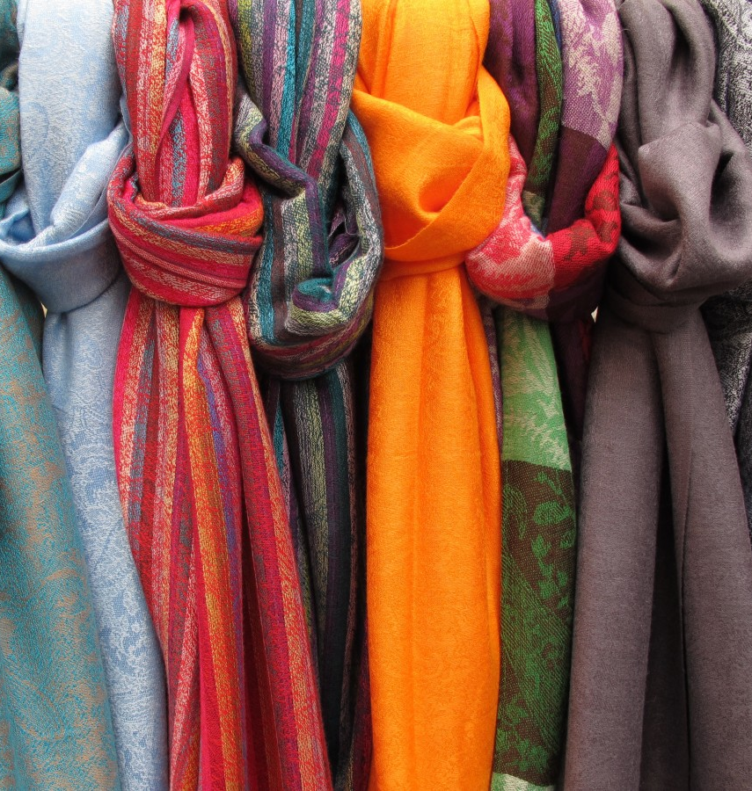
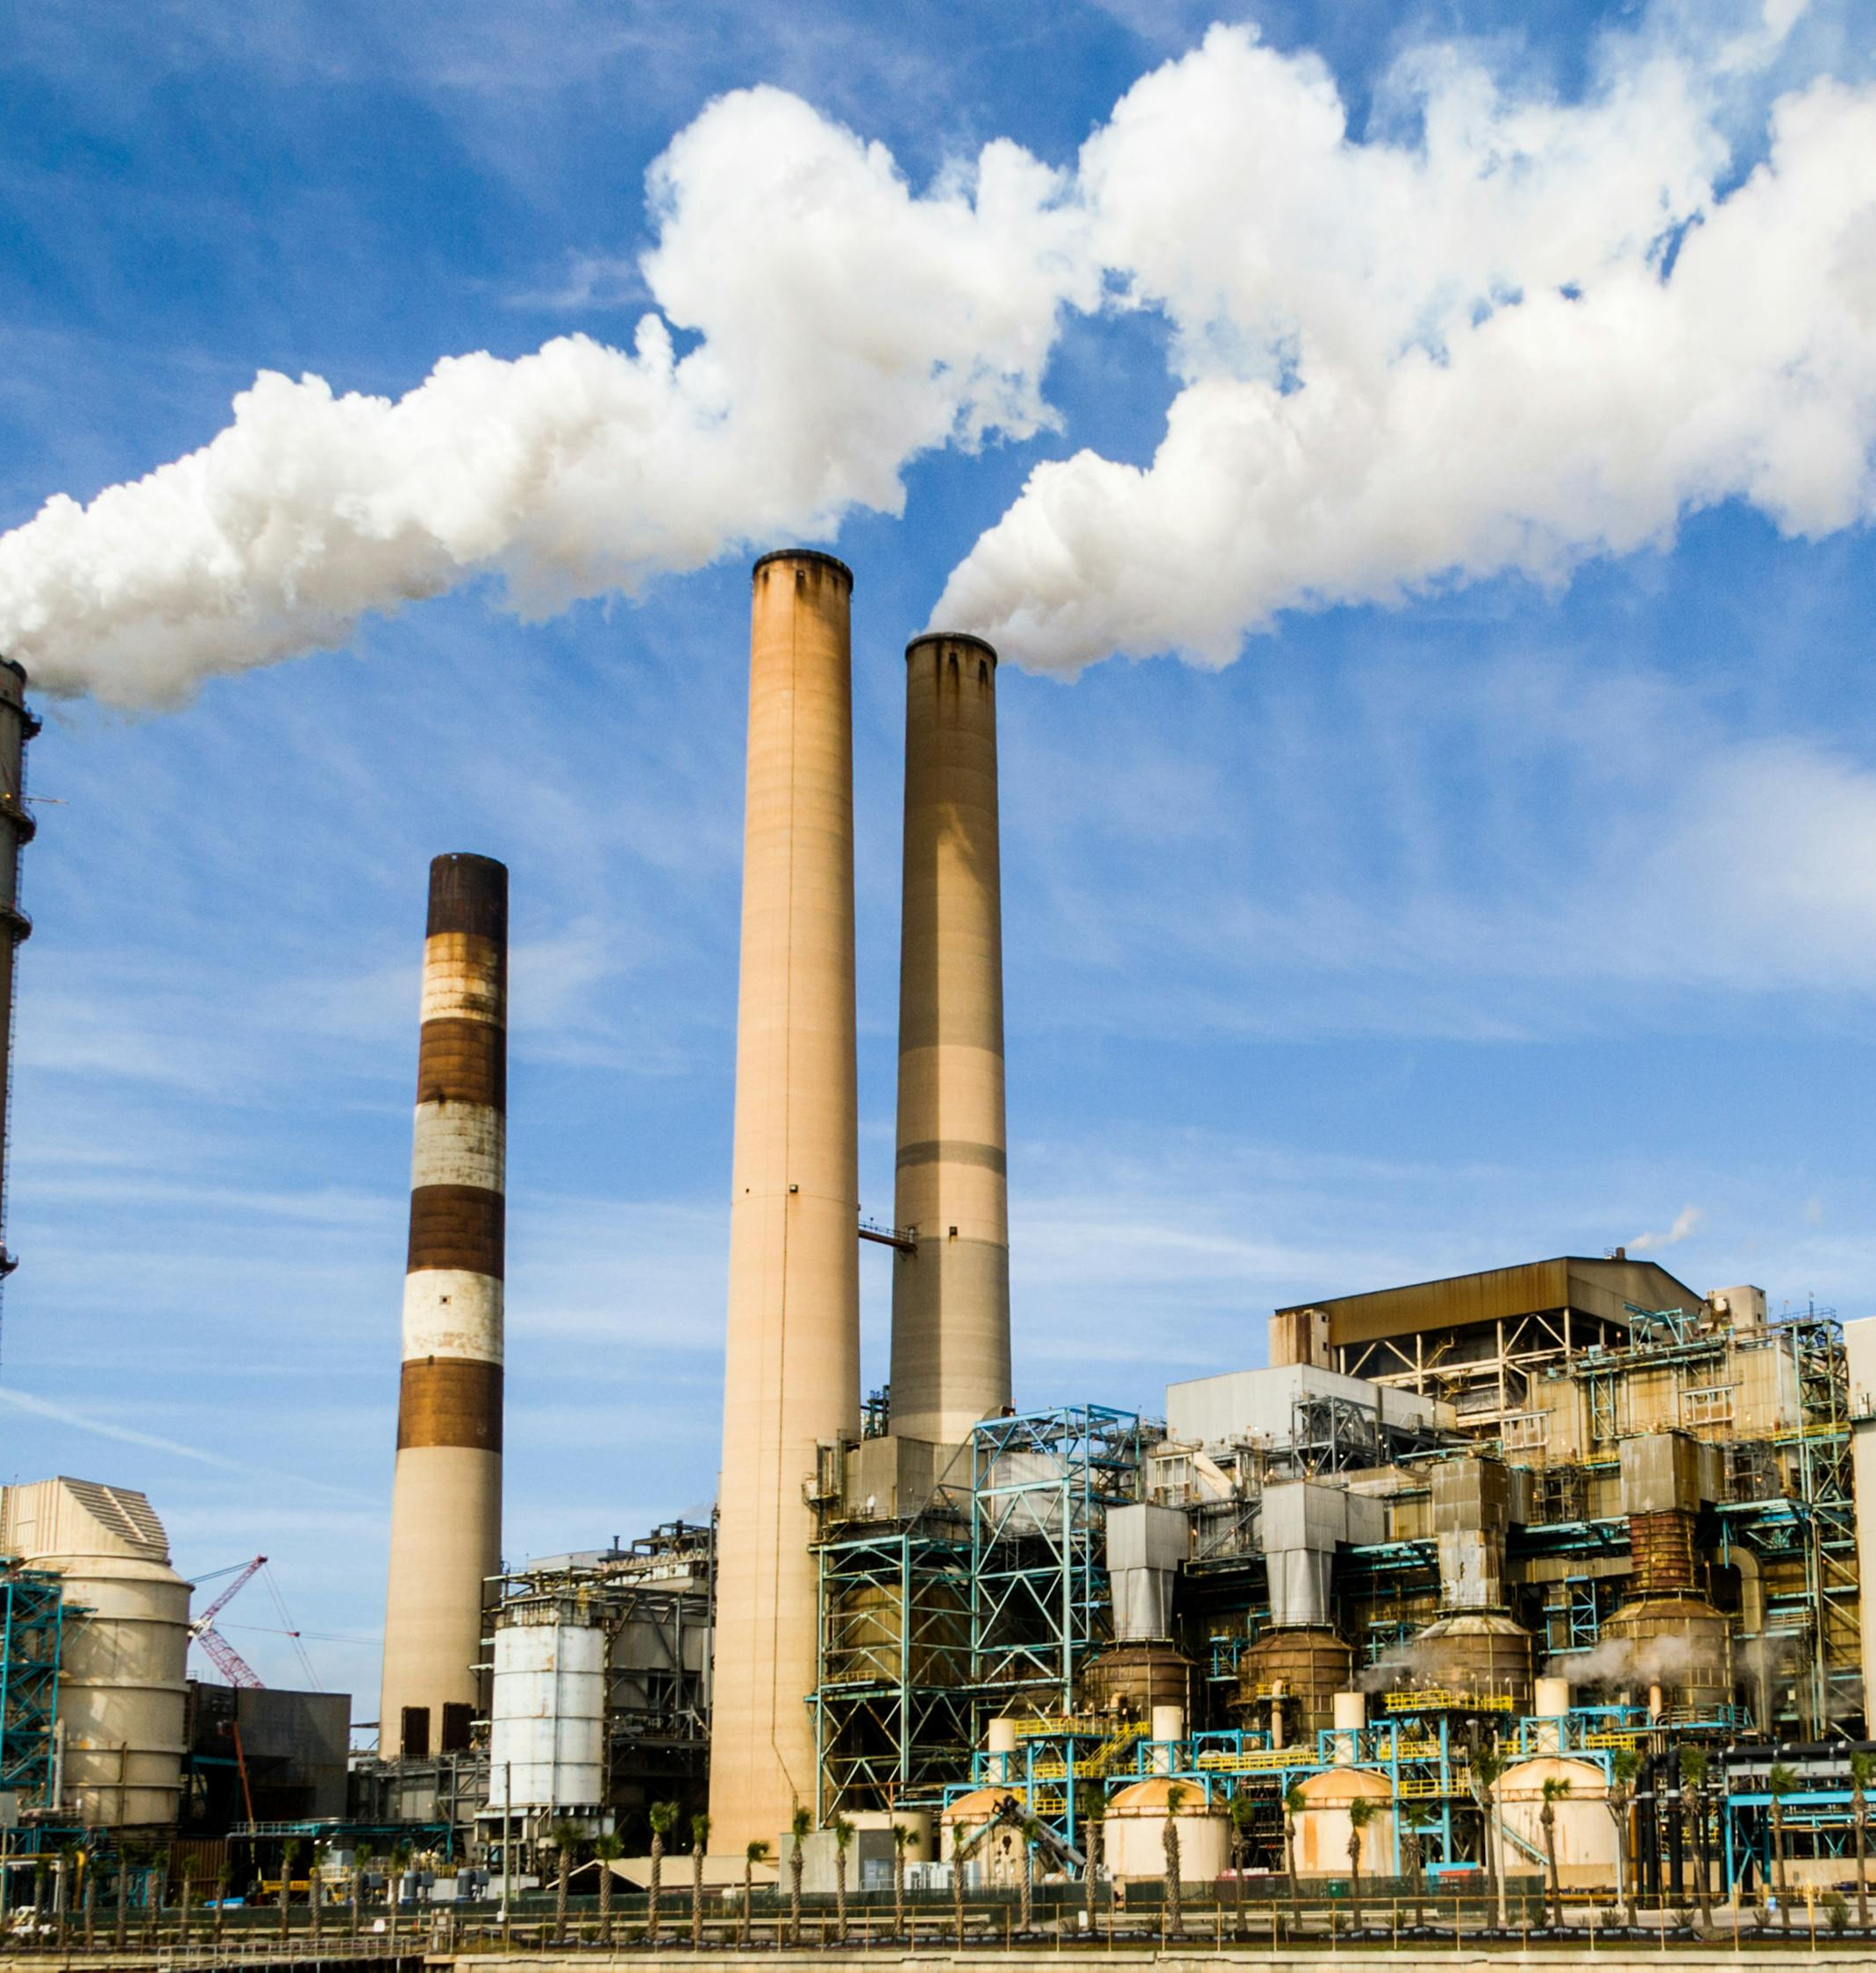
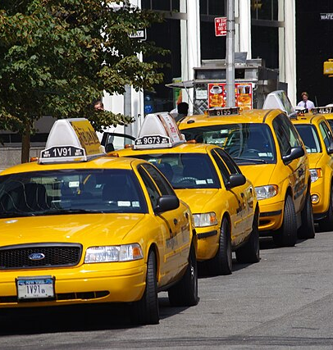
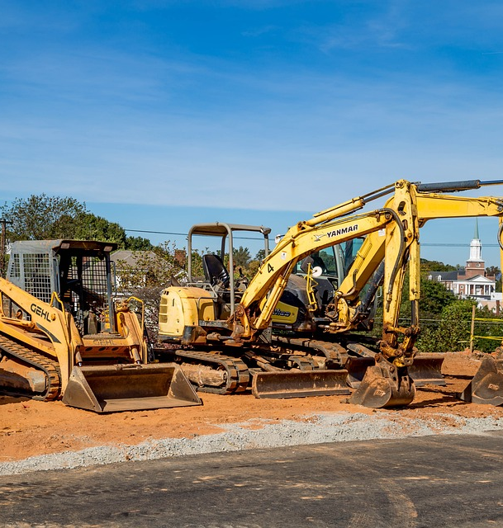
Scope 1 Emissions
Emissions that are directly emitted by the organization from sources it owns and controls.
These can be reduced by lowering energy use, switching to renewable alternatives, choosing more fuel-efficient ways.
Examples include factory machinery, trucks/vehicles, textile production, factory boilers
https://youtu.be/bVCZ35GJUmA

Slide 4

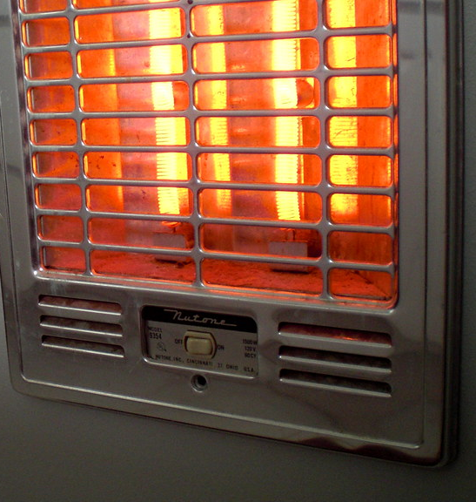
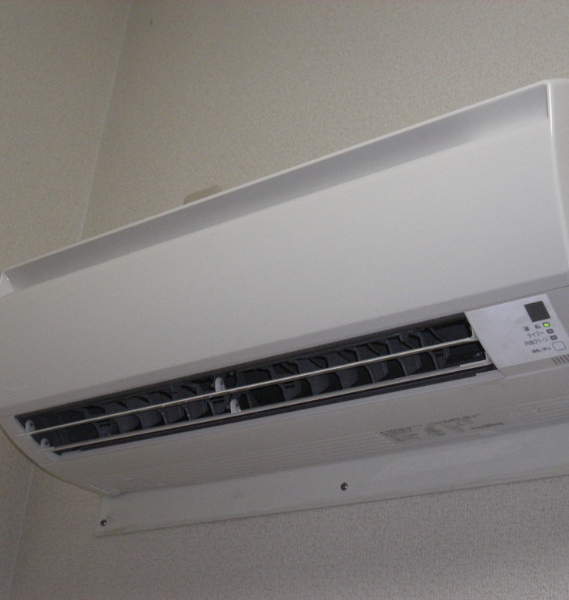
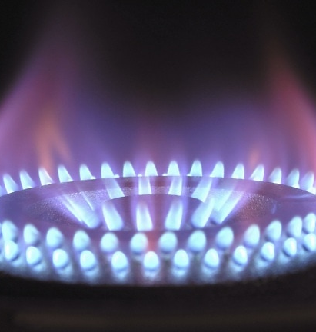
Scope 2 Emissions
Indirect emissions from purchasing and using electricity, steam, heat or cooling. Gases are emitted off-site where the manufacturer is responsible for producing the gases but businesses who purchase from these manufacturers contribute to these emissions by supporting the manufacturers.
These can be reduced by lowering energy use, choose renewable energy suppliers, upgrade systems with friendlier alternatives.
https://youtu.be/yjgZNe7k83I

Slide 5


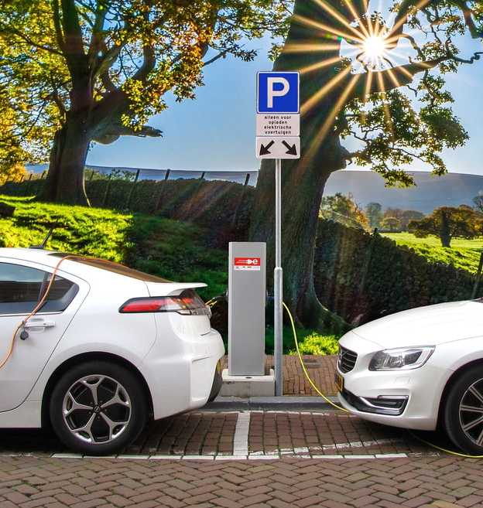
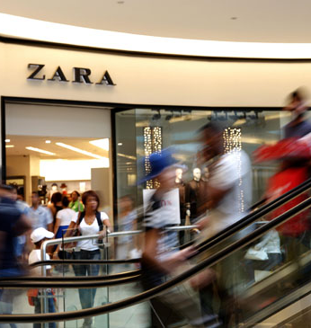
Scope 3 Emissions
Indirect emissions that contribute the most to greenhouse gases, typically 90% of all greenhouse gases. This is because the gases have a cumulative effect across the entire supply chain including the final customer. These gases are not part of scopes 1 and 2 emissions.
Scope 3 is often known as life-cycle emissions because it starts with the manufacturer and ends with the retail customer.
These can be reduced by working with suppliers, recycling, design a circular product, alternative transport options
Examples: packaging, delivery, waste disposal
https://youtu.be/B3-qnGu1a_8

Slide 6
Additional Resources
Greenhouse gas emissions –Scopes 1, 2 and 3
https://youtu.be/xkG8i_4mdCM
Scope Emissions, Explained – Scope 1, Scope 2, Scope 3
https://youtu.be/NvZL3Z8xIlU
Scope 1, 2 and 3 Explained | Climate Partner
https://youtu.be/0Z_X7iZdLEk

Slide 7

Scope 3
The largest polluter
Supplier and Customer Selection
Select suppliers that minimize their own carbon footprints.
Product Specification
Adjust product materials to rely more on lower-emission alternatives.
Partnerships
Working with other businesses to create new technologies that lower carbon footprints in product lines and processes.
End-of-Life Solution
Recycle materials. Create circular solutions where customer waste from products bought are reused again in the production of new products.
Green Portolio Strategies
New product lines that are eco-friendly that complement main product lines.
Value Chain Integration
Creating new opportunities in production processes that reduce overall carbon footprint.
SOLUTIONS

Slide 8
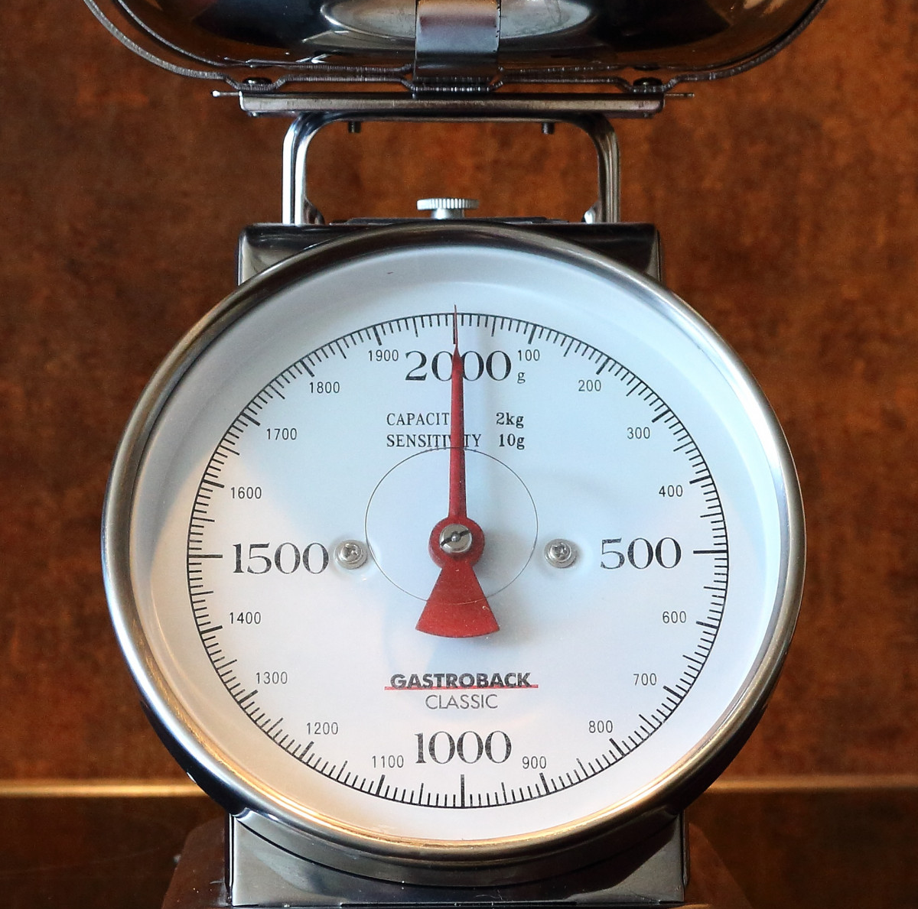
Measuring emissions is the first step for companies trying to reduce their overall footprint.
Once they know how much damage their causing, then fixes can begin.

