Slide 1

Back to Basics General Ledgers and General Journal
Marianne Riley-Dunstan
BEWA Conference 2025

Slide 2
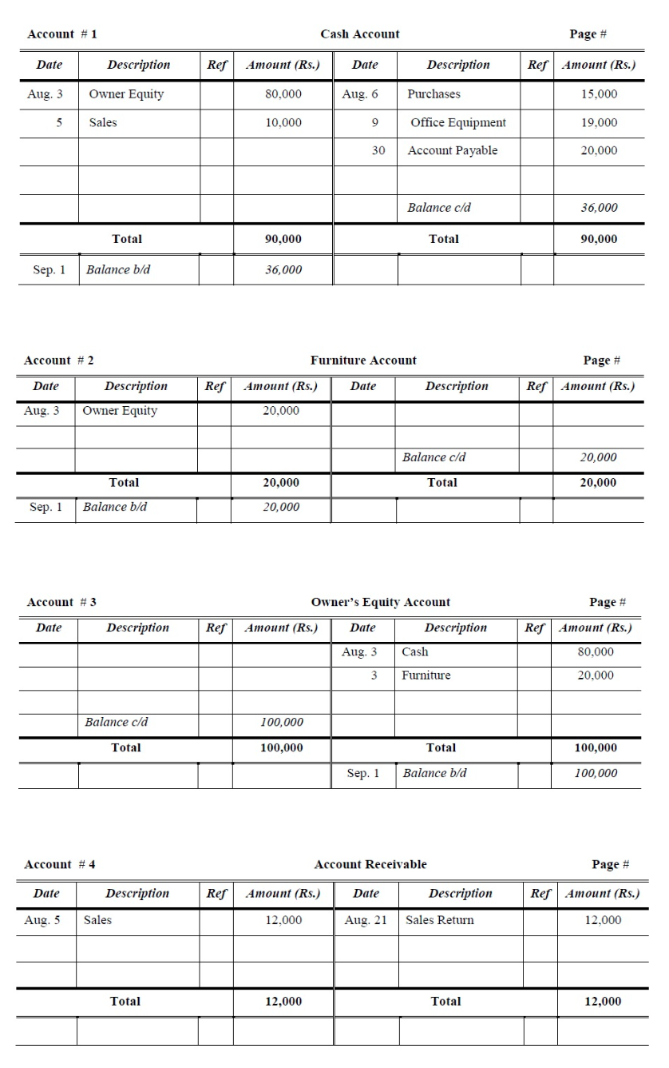
The Accounting Cycle
and
The General Ledger
Marianne Riley-Dunstan
Marianne.Riley@education.wa.edu.au
BEWA Conference 2025

Slide 3
The accounting cycle is the collective process of identifying, analysing, and recording the accounting events of a business. The series of steps begins when a transaction occurs and ends with its inclusion in the financial statements.
Assets
Liabilities
Owners Equity/Capital
Income/Revenue
Expenses
Balance sheet
Statement of financial position
Profit and Loss statement
Income statement
Statement of financial performance

Slide 4
Students will understand the double entry accounting system
Students will understand the rules of accounting
Students will create a general ledger accounts for transactions in a business
Students can explain the debit and credit nature of general ledger accounts
Students can accurately create general ledger entries for given business transactions

Slide 5
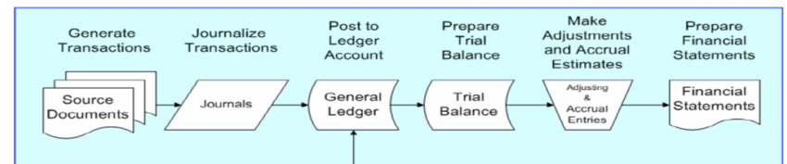
The accounting process
The accounting cycle is the collective process of identifying, analysing, and recording the accounting events of a business. The series of steps begins when a transaction occurs and ends with its inclusion in the financial statements.
The steps in the accounting cycle are:
Source documents (transaction occurs)
General Journals (identifying)
General ledger (analysing and recording)
Adjusting entries and Closing entries
Financial Statements (Balance Sheet and Income Statement)

Slide 6
The accounting process
The General Ledger is an accounting record. It contains all the individual business accounts, showing details of all the transactions that have taken place in the accounting period.
In a manual accounting system, the information from each source document is transferred into journals and then totals are transferred into the General Ledger.
The step requiring an entry in the journals can be missed so we won’t be looking at these . Today. We will focus on understanding the General Ledger and the double entry system.

Slide 7

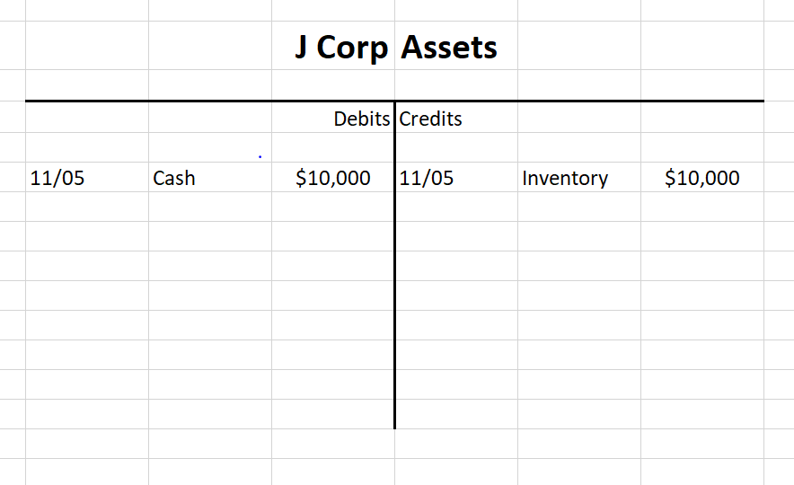
TRANSACTIONS
Debits and credits are terms used by bookkeepers and accountants when recording transactions in the general journal and general ledger.
https://www.youtube.com/watch?v=j71Kmxv7smk

Slide 8
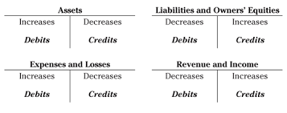
Debits and Credits
Using the double entry system of accounting ensures that the accounting equation,
Simple: assets = liabilities + owner's equity (A=L+Eq)
Extended: assets + expenses = liabilities + owner's equity +income (A+E=L+I+Eq)
will always be in balance.
The total debits and credits for a transaction must BALANCE. This means they must always equal each other. If transactions do not balance, then you cannot create financial reports.
Using this two-column recording format is ESSENTIAL
to most controls of accounting accuracy.

Slide 9
Creating general ledger accounts
A common format for ledger accounts is the T-form as shown below.
Account Name A/c
Date | Details | Details | Amount | Date | Particulars | Amount
Record the date the transaction took place | Name the account where the corresponding Credit entry occurred | Name the account where the corresponding Credit entry occurred | Record the $ value of the transaction | Record the date the transaction took place | Name the account where the corresponding Debit entry occurred | Record the $ value of the transaction
This is called the DEBIT (dr) side |  |  |  | This is called the CREDIT (Cr) side

Slide 10
Debits and Credits
When you record ANY transactions, you need to record two sides to the transaction.
One goes on the debit (Left) side and the other on the credit (Right) side.
A debit INCREASES the asset or expense account and DECREASES a liability, income and equity account
A credit DECREASES the asset or expense account and INCREASES a liability, income and equity account
Whenever an accounting transaction is created, at least two accounts will be impacted, with a debit entry against one account and a credit entry against another. There is no maximum number of entries but a minimum of two. This is called double-entry accounting.

Slide 11

Accounting Rules - Debits and Credits:
Asset accounts: A debit increases the balance, and a credit decreases the balance.
Liability accounts: A debit decreases the balance, and a credit increases the balance
Owners’ equity accounts: A debit decreases the balance and credit increases the balance
Revenue/Income accounts: A debit decreases the balance, and a credit increases the balance.
Expense accounts: A debit increases the balance, and a credit decreases the balance.
Debit in Nature
Credit in Nature

Slide 12
Debit and Credit nature, GL accounts
Let’s draw some GL T-accounts to practice this.
Liabilities and Equity GL accounts
Asset and Expense GL accounts
CREDIT NATURE
DEBIT NATURE
Revenue and Income GL accounts
CREDIT NATURE

Slide 13
Posting to the General Ledger
Posting to the ledger means transferring the information into the ledger accounts. There are three steps involved:
Step 1 Identify which accounts are affected (two minimum).
Step 2 Identify how they are affected increasing or decreasing (debit (Dr) or credit (Cr))
Step 3 Record in the general ledger account

Slide 14
TRANSACTION | FIRST EFFECT | SECOND EFFECT
Owner contributed $10 000 to the business
Owner contributed a computer and printer worth $3 500
Bought office equipment on credit from Office Supplies for $1 000
Took out a premises mortgage for $200 000
Owner withdrew the computer worth $2 000 for use at home
Took out a $5 000 loan from Happy Days Bank

Slide 15
TRANSACTION | FIRST EFFECT | SECOND EFFECT
Owner contributed $10 000 to the business | Cash at Bank | Capital – Your name
Owner contributed a computer and printer worth $3 500
Bought office equipment on credit from Office Supplies for $1 000
Took out a premises mortgage for $200 000
Owner withdrew the computer worth $2 000 for use at home
Took out a $5 000 loan from Happy Days Bank

Slide 16
TRANSACTION | FIRST EFFECT | SECOND EFFECT
Owner contributed $10 000 to the business | Cash at Bank | Capital – Your name
Owner contributed a computer and printer worth $3 500 | Office equipment | Capital
Bought office equipment on credit from Office Supplies for $1 000 | Office equipment | Accounts payable
Took out a premises mortgage for $200 000 | Premises or Cash at bank | Loan -Mortgage
Owner withdrew the computer worth $2 000 for use at home | Drawings | Office equipment
Took out a $5 000 loan from Happy Days Bank | Cash at bank | Loan – Happy Days Bank

Slide 17
Dr A = L + Eq Cr
TRANSACTION | FIRST EFFECT | SECOND EFFECT
Owner contributed $10 000 to the business | Cash at Bank | Capital -
Owner contributed a computer and printer worth $3 500 | Office equipment | Capital
Bought office equipment on credit from Office Supplies for $1 000 | Office equipment | Accounts payable
Took out a premises mortgage for $200 000 | Premises or Cash at bank | Loan -Mortgage
Owner withdrew the computer worth $2 000 for use at home | Drawings | Office equipment
Took out a $5 000 loan from Happy Days Bank | Cash at bank | Loan – Happy Days Bank

Slide 18
Posting to the General Ledger
Date | TRANSACTION | ACCOUNT NAMES | CLASSIFICATION | INCREASE OR DECREASE | DEBIT OR CREDIT
May 1 | Owner contributed $10 000 to the business | Cash at Bank Capital – Your name | Asset Equity | Inc Inc | Dr Cr
May 2 | Owner contributed a computer and printer worth $3 500 | Office equipment Capital - Your name | Asset Equity | Inc Inc | Dr Cr
May 3 | Bought office equipment on credit from Office Supplies for $1 000 | Office equipment Accounts payable | Asset Liability | Inc Inc | Dr Cr
May 4 | Took out a premises mortgage for $200 000 | Premises or Cash at bank Loan - Mortgage | Asset Liability | Inc Inc | Dr Cr
May 5 | Owner withdrew the computer worth $2 000 for use at home | Drawings Office equipment | Equity Asset | Dec Dec | Dr Cr
May 6 | Took out a $5 000 loan from Happy Days Bank | Cash at bank Loan – Happy Days Bank | Asset Liability | Inc Inc | Dr Cr
Follow the rules 1. Identify 2. Effect 3. Record

Slide 19
1.The owner contributed$10 000 to commence the business.
Cash At Bank
Date | Details | Amount | Date | Particulars | Amount
1 May 2025 | Capital | 10 000
Capital – Your name
Date | Details | Amount | Date | Particulars | Amount
 |  |  | 1 May 2025 | Cash at bank | 10 000
Follow the rules 1. Identify 2. Effect 3. Record

Slide 20
Posting to the General Ledger
Date | TRANSACTION | ACCOUNT NAMES | CLASSIFICATION | INCREASE OR DECREASE | DEBIT OR CREDIT
May 1 | Owner contributed $10 000 to the business | Cash at Bank Capital – Your name | Asset Equity | Inc Inc | Dr Cr
May 2 | Owner contributed a computer and printer worth $3 500 | Office equipment Capital - Your name | Asset Equity | Inc Inc | Dr Cr
May 3 | Bought office equipment on credit from Office Supplies for $1 000 | Office equipment Accounts payable | Asset Liability | Inc Inc | Dr Cr
May 4 | Took out a premises mortgage for $200 000 | Premises or Cash at bank Loan - Mortgage | Asset Liability | Inc Inc | Dr Cr
May 5 | Owner withdrew the computer worth $2 000 for use at home | Drawings Office equipment | Equity Asset | Dec Dec | Dr Cr
May 6 | Took out a $5 000 loan from Happy Days Bank | Cash at bank Loan – Happy Days Bank | Asset Liability | Inc Inc | Dr Cr
Follow the rules 1. Identify 2. Effect 3. Record

Slide 21
2. Owner contributed a computer and printer worth $3 500
Office Equipment
Date | Details | Amount | Date | Particulars | Amount
2025 2 May | Capital – Your name | 3 500
Capital – Your name
Date | Details | Amount | Date | Particulars | Amount
 |  |  | 2025 1 May | Cash at bank | 10 000
 |  |  | 2 May | Office Equipment | 3 500
Follow the rules 1. Identify 2. Effect 3. Record

Slide 22
Cash At Bank
Date | Details | Amount | Date | Particulars | Amount
1 May 2025 | Capital – Your name | 10 000
Capital – Your name
Date | Details | Amount | Date | Particulars | Amount
 |  |  | 1 May 2025 | Cash at bank | 10 000
Office Equipment
Date | Details | Amount | Date | Particulars | Amount
2 May 2025 | Capital – Your name | 3 500
Capital – Your name
Date | Details | Amount | Date | Particulars | Amount
 |  |  | 1 May 2025 | Cash at bank | 10 000
 |  |  | 2 May | Office Equipment | 3 500

Slide 23
Your turn, complete the remainder of the May transactions on your general ledger cards.
Date | TRANSACTION | ACCOUNT NAMES | CLASSIFICATION | INCREASE OR DECREASE | DEBIT OR CREDIT
May 1 | Owner contributed $10 000 to the business | Cash at Bank Capital – Your name | Asset Equity | Inc Inc | Dr Cr
May 2 | Owner contributed a computer and printer worth $3 500 | Office equipment Capital - Your name | Asset Equity | Inc Inc | Dr Cr
May 3 | Bought office equipment on credit from Office Supplies for $1 000 | Office equipment Accounts payable | Asset Liability | Inc Inc | Dr Cr
May 4 | Took out a premises mortgage for $200 000 | Premises or Cash at bank Loan - Mortgage | Asset Liability | Inc Inc | Dr Cr
May 5 | Owner withdrew the computer worth $2 000 for use at home | Drawings Office equipment | Equity Asset | Dec Dec | Dr Cr
May 6 | Took out a $5 000 loan from Happy Days Bank | Cash at bank Loan – Happy Days Bank | Asset Liability | Inc Inc | Dr Cr
Follow the rules 1. Identify 2. Effect 3. Record

Slide 24
All accounting transactions need to have a minimum of two entries. One is a debit and one is a credit.
All accounts with a debit nature will increase when a debit is added to them and reduce when a credit is added to them.
All accounts with a credit nature will increase in amount when a credit is added to them and will reduce when a debit is added.
The total number of debits must be equal the total amount of credits in a transaction.

Slide 25
The Accounting Cycle
and
The General Journal

Slide 26

What is the accounting equation?
A=L+Eq
What are the 3 rules for recording transactions in the general ledger accounts?
1) Identify
2) Effect
3) Record
What terms do accountants and bookkeepers use when recording transactions?
Debits and Credits

Slide 27
Students will understand the double entry accounting system
Students will understand the rules of accounting
Students will create a general journal for transactions in a business
Students can explain the recording process in the general journal
Students can accurately create general journal entries for given business transactions

Slide 28
The accounting process
The accounting cycle is the collective process of identifying, analysing, and recording the accounting events of a business. The series of steps begins when a transaction occurs and ends with its inclusion in the financial statements.
The steps in the accounting cycle are:
Source documents (transaction occurs)
General Journals (identifying)
General ledger (analysing and recording)
Adjusting entries and Closing entries
Financial Statements (Balance Sheet and Income Statement)

Slide 29
In a manual accounting system, the information from each source document is transferred into journals and then totals are transferred into the General Ledger.
The step requiring an entry in the journals can be missed.
Instead, we focused on understanding the General Ledger and the double entry system.
General Journal
Date | Ledger Accounts | Debit | Credit

Slide 30
Date | TRANSACTION | ACCOUNT NAMES | CLASSIFICATION | INCREASE OR DECREASE | DEBIT OR CREDIT
May 1 | Owner contributed $10 000 to the business | Cash at Bank Capital – Your name | Asset Equity | Inc Inc | Dr Cr
May 2 | Owner contributed a computer and printer worth $3 500 | Office equipment Capital - Your name | Asset Equity | Inc Inc | Dr Cr
May 3 | Bought office equipment on credit from Office Supplies for $1 000 | Office equipment Accounts payable | Asset Liability | Inc Inc | Dr Cr
May 4 | Took out a premises mortgage for $200 000 | Premises or Cash at bank Loan - Mortgage | Asset Liability | Inc Inc | Dr Cr
May 5 | Owner withdrew the computer worth $2 000 for use at home | Drawings Office equipment | Equity Asset | Dec Dec | Dr Cr
May 6 | Took out a $5 000 loan from Happy Days Bank | Cash at bank Loan – Happy Days Bank | Asset Liability | Inc Inc | Dr Cr
Posting to the General Ledger
Follow the rules 1. Identify 2. Effect 3. Record

Slide 31
Posting to the General Journal
General Journal
Date | Ledger Accounts | Debit | Credit
Year | Account #1 | $
 | Indent Account #2 |  | $
 | Narration (story)
Date | TRANSACTION | ACCOUNT NAMES | CLASSIFICATION | INCREASE OR DECREASE | DEBIT OR CREDIT
May 1 | Owner contributed $10 000 to the business | Cash at Bank Capital – Your name | Asset Equity | Inc Inc | Dr Cr
May 2 | Owner contributed a computer and printer worth $3 500 | Office equipment Capital - Your name | Asset Equity | Inc Inc | Dr Cr

Slide 32
Posting to the General Journal
Date | TRANSACTION | ACCOUNT NAMES | CLASSIFICATION | INCREASE OR DECREASE | DEBIT OR CREDIT
May 1 | Owner contributed $10 000 to the business | Cash at Bank Capital – Your name | Asset Equity | Inc Inc | Dr Cr
Posting to the General Ledger
General Journal
Date | Ledger Accounts | Debit | Credit

Slide 33
Posting to the General Journal
Date | TRANSACTION | ACCOUNT NAMES | CLASSIFICATION | INCREASE OR DECREASE | DEBIT OR CREDIT
May 1 | Owner contributed $10 000 to the business | Cash at Bank Capital – Your name | Asset Equity | Inc Inc | Dr Cr
Posting to the General Ledger
General Journal
Date | Ledger Accounts | Debit | Credit
May 1 | Cash at Bank | $10 000
 | Capital – Your name |  | $10 000
 | Owner contributed to the business

Slide 34
Posting to the General Journal
Date | TRANSACTION | ACCOUNT NAMES | CLASSIFICATION | INCREASE OR DECREASE | DEBIT OR CREDIT
May 2 | Owner contributed a computer and printer worth $3 500 | Office equipment Capital - Your name | Asset Equity | Inc Inc | Dr Cr
Posting to the General Ledger
General Journal
Date | Ledger Accounts | Debit | Credit

Slide 35
Posting to the General Journal
Date | TRANSACTION | ACCOUNT NAMES | CLASSIFICATION | INCREASE OR DECREASE | DEBIT OR CREDIT
May 2 | Owner contributed a computer and printer worth $3 500 | Office equipment Capital - Your name | Asset Equity | Inc Inc | Dr Cr
Posting to the General Ledger
General Journal
Date | Ledger Accounts | Debit | Credit
May 2 | Office equipment | $3 500
 | Capital – Your name |  | $3 500
 | Owner contributed a computer and printer

Slide 36
Posting to the General Journal
General Journal
Date | Ledger Accounts | Debit | Credit
May 1 | Cash at Bank | $10 000
 | Capital – Your name |  | $10 000
 | Owner contributed to the business
May 2 | Office equipment | $3 500
 | Capital – Your name |  | $3 500
 | Owner contributed a computer and printer

Slide 37
Your turn, complete the remainder of the May transactions on your general journal.
Date | TRANSACTION | ACCOUNT NAMES | CLASSIFICATION | INCREASE OR DECREASE | DEBIT OR CREDIT
May 1 | Owner contributed $10 000 to the business | Cash at Bank Capital – Your name | Asset Equity | Inc Inc | Dr Cr
May 2 | Owner contributed a computer and printer worth $3 500 | Office equipment Capital - Your name | Asset Equity | Inc Inc | Dr Cr
May 3 | Bought office equipment on credit from Office Supplies for $1 000 | Office equipment Accounts payable | Asset Liability | Inc Inc | Dr Cr
May 4 | Took out a premises mortgage for $200 000 | Premises or Cash at bank Loan - Mortgage | Asset Liability | Inc Inc | Dr Cr
May 5 | Owner withdrew the computer worth $2 000 for use at home | Drawings Office equipment | Equity Asset | Dec Dec | Dr Cr
May 6 | Took out a $5 000 loan from Happy Days Bank | Cash at bank Loan – Happy Days Bank | Asset Liability | Inc Inc | Dr Cr
Follow the rules 1. Identify 2. Effect 3. Record

Slide 38
Students will understand the double entry accounting system
Students will understand the rules of accounting
Students will create a general journal for transactions in a business
Students can explain the recording process in the general journal
Students can accurately create general journal entries for given business transactions

