Slide 1

BEWA Conference 2025, Ambrose Estate, Wembley Downs
29 August 2025
Accounting and Sustainability Standards Update
Dr Lyndie Bayne (FCA)
-Chair, Chartered Accountants ANZ Sustainability Working Group WA
-Senior Lecturer in Accounting
-The University of Western Australia Business School

Slide 2

BEWA Conference 2025, Ambrose Estate, Wembley Downs
29 August 2025
AGENDA
Sustainability Standards Update: IFRS/AASB S2 Climate-related Disclosures
Accounting Standards Update: IFRS/AASB 18 Presentation and Disclosure in Financial
Statements

Slide 3
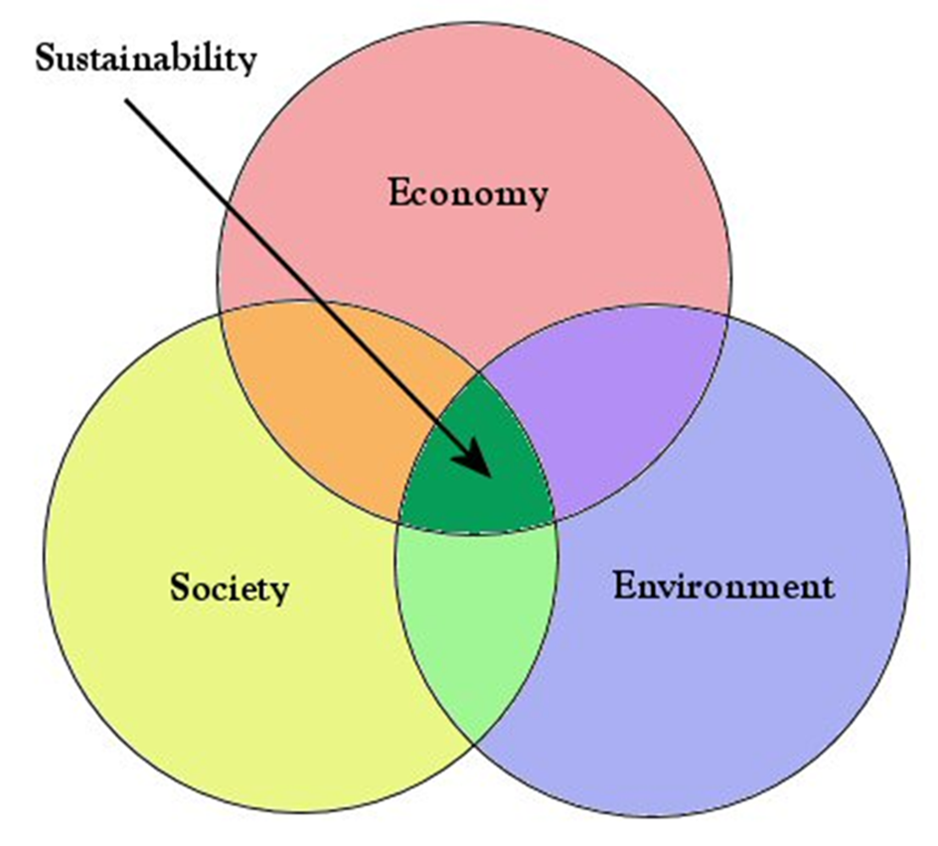
What is ‘sustainability’?
1987, the World Commission on Environment and Development (WCED), ‘Brundtland Commission’ report:
‘Sustainable Development’:
  development that meets the needs of the present without compromising the ability of future generations to meet their own needs.

Slide 4

What is included in ‘sustainability’?

Slide 5
Various names for sustainability reporting
(some differences but used interchangeably)
ESG + E (Enviro socio gov + Econ/financial)
Sustainability reporting
PPP (People, planet, profit)
CSR (corporate social responsibility)
Non-financial, narrative reporting
Triple bottom line
ESG (enviro, social, governance)

Slide 6
Global sustainability reporting milestone events
10 yrs
    1987 UN Brundtland Report ‘Sustainable development’
    1997 Kyoto Protocol
    1997 Global Reporting Initiative (GRI) formation – voluntary sustainability reporting guidelines
    2014 EU Commissions’ Non-Financial Reporting Directive (NFRD) (2014) – voluntary to mandatory
    2015 Paris Agreement
    2016 UN Sustainable Development Goals
    2017 Taskforce for Climate-related Financial Disclosures Recommendations (TCFD)
    2021 Formation of the International Sustainability Standards Board (ISSB)
    2022 EU Corporate Sustainability Reporting Directive (CSRD)
    2022 Value Reporting Foundation (IIRC and SASB) and CDSB consol into IFRS Foundation
    2023 ISSB IFRS S1 (General Sustainability) and S2 (Climate-related)
    2023 European Sustainability Reporting Standards (ESRS) 12 stds
    2023 TNFD recommendations
    2024 SEC Climate rule; paused
    2025 ISSA 5000 (Sustainability Assurance Engagements) (IAASB)
    2025 IESBA Global Ethics Sustainability Standards, independence
17 yrs
7 yrs
5 yrs

Slide 7




Four global sustainability standard setting powerhouses
The ‘Big 4’

Slide 8


Differences in fundamental concepts of ‘Big 4’
A note on materiality (what is included or not in reporting)
Important concept
Co A
Environment
and
society
Impact materiality
Co A
Environment
and
society
Financial materiality
Co A
Environment
and
society
https://www.etsy.com/au/listing/510527211/
Double materiality

Slide 9
Four global sustainability standard setting powerhouses
Financial materiality
Double materiality
Financial materiality
Impact materiality

Slide 10
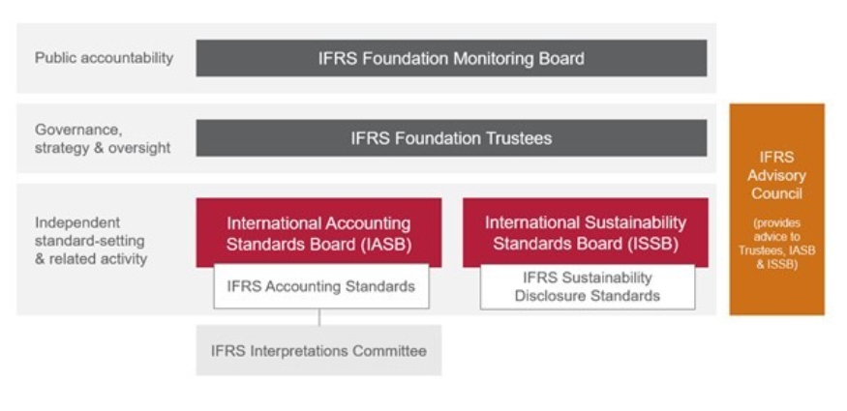
POWERHOUSE 1 - International Sustainability standards Board (ISSB)
The Accountants
SINCE 2021
Source: https://www.ifrs.org/groups/international-sustainability-standards-board/issb-frequently-asked-questions/

Slide 11
POWERHOUSE 1 - International Sustainability standards Board (ISSB)
IFRS S1 General Requirements for Disclosure of Sustainability-related Financial Information
IFRS S2 Climate-related disclosures
-Based on the TCFD (Taskforce on Climate-related Financial Disclosure) and SASB industry standards
Both 4 pillars of reporting (from TCFD):
Governance
Strategy
Risk Management
Metrics and Targets
The Accountants

Slide 12

‘Climate First, not Climate only’
Australia
Mandatory Climate Reporting - Companies
September 2024: AASB S1 (voluntary) and AASB S2 (mandatory for some)
AASB S2 not exactly the same as IFRS S2 (e.g. don’t need to refer to SASB industry standards)
Large companies (reporting entities who are required to prepare financial reports under Chapter 2M of the Corporation Act 2001 which are included in scope of the legislation and meet thresholds).
Corporate annual report: Financial statements, Directors’ report, Auditors’ report, Sustainability / Climate Report
Assurance report from their financial auditors
Starting on or after 1 January 2025 (three groups are phased in)
Assurance: limited and then reasonable from year 4

Slide 13
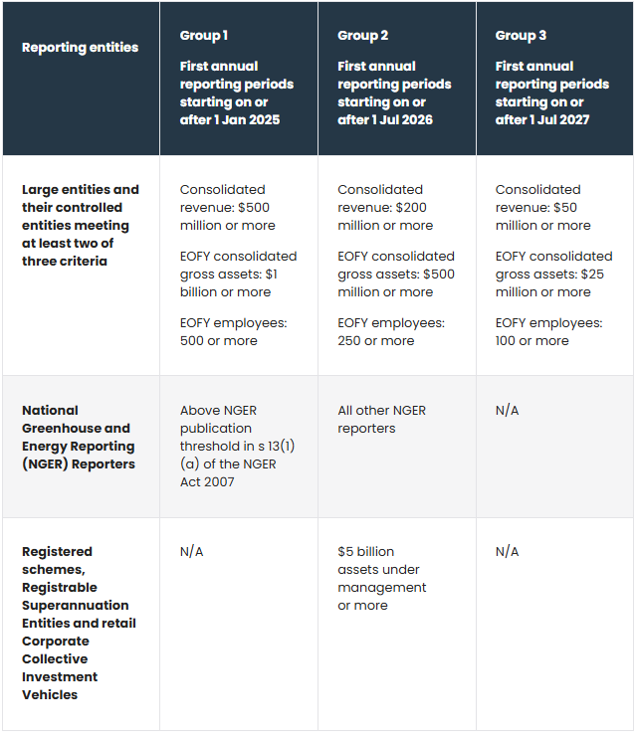
Size Thresholds for Section 2M reporters

Slide 14
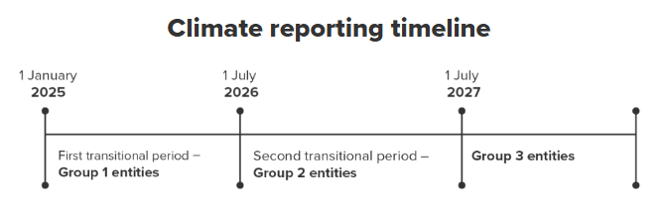
Australia mandatory reporting timeline - companies

Slide 15
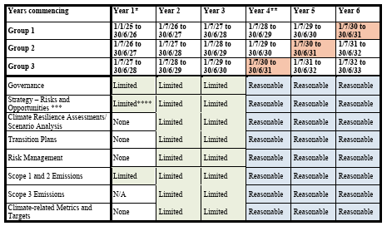
Assurance timeline ASSA 5010

Slide 16
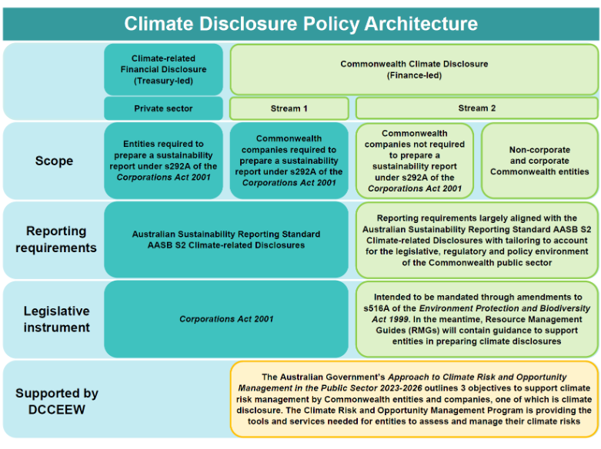
Australia Commonwealth Climate disclosure – Public Sector
Public sector
IPSASB: SRS Exposure Draft 1, Climate-related Disclosures

Slide 17
Mandatory climate disclosure IFRS S2 / AASB S2
AASB S2 Climate-related Disclosures
“The objective of AASB S2 Climate-related Disclosures is to require an entity to disclose information about its climate-related risks and opportunities that is useful to primary users of general purpose financial reports in making decisions relating to providing resources to the entity.” (AASB S2, para1).

Slide 18

Mandatory climate disclosure IFRS S2 / AASB S2
IFRS/AASB S2 Four Pillars of disclosures:
Governance
Strategy
Risk management
Metrics and Targets

Slide 19
Mandatory climate disclosure IFRS S2 / AASB S2
Climate-related risks
“the potential negative effects of climate change on an entity” (IFRS S2 p.19).
Climate-related physical risks
Risks related to the physical impacts of climate change, such as the impact of storms, floods, drought or heatwaves on the entity and its value chain, which are increasing in severity and frequency
Climate-related transition risks
Risks related to the transition to a lower-carbon economy, such as the impact of carbon pricing mechanisms and policies promoting sustainable land-use practices

Slide 20
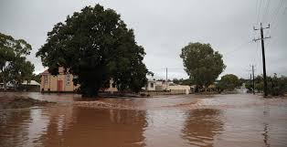
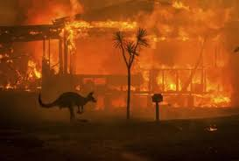
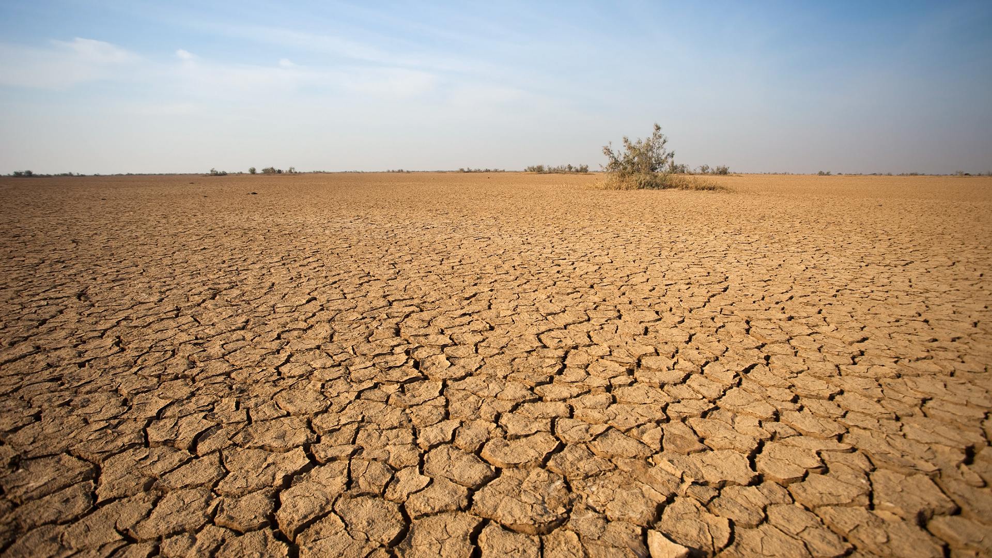
Mandatory climate disclosure IFRS S2 / AASB S2
Climate-related physical risks | Risks resulting from climate change that can be event-driven (acute physical risk) or from longer-term shifts in climatic patterns (chronic physical risk) (IFRS S2 p.19)
-Acute physical risk | Arise from weather-related events such as storms, floods, drought or heatwaves, which are increasing in severity and frequency (IFRS S2 p.19)
-Chronic physical risk | Arise from longer-term shifts in climatic patterns including changes in precipitation and temperature which could lead to sea level rise, reduced water availability, biodiversity loss and changes in soil productivity (IFRS S2 p.19)
https://www.dfes.wa.gov.au/hazard-information/flood/during
https://www.bbc.com/news/in-pictures-50971879
https://www.innovationnewsnetwork.com/exploring-long-term-effects-drought/25574/

Slide 21
Mandatory climate disclosure IFRS S2 / AASB S2
Climate-related transition risks | Risks that arise from efforts to transition to a lower-carbon economy. Transition risks include policy, legal, technological, market and reputational risks” (IFRS S2 p.19)
-Policy and legal / litigation risk | Risks related to climate-related policies such as to limit actions that contribute to adverse effects of climate change and policies that seek to promote adaptation to climate change. E.g. carbon pricing mechanisms, promoting sustainable land-use practices, encouraging greater water efficiency (TCFD, 2017, p.5) Risks related to cases being brought against entities for issues such as failure to mitigate impacts of climate change, failure to adapt to climate change ana insufficient disclosure around material financial risks (TCFD, 2017, p.5)
-Technology risk | Risks related to adopting technological improvements and innovations related to climate, such as increase in input costs and the scalability of the technology (TCFD, 2017, p.6)
-Market risk | Risks related to changes in the supply and demand for certain commodities, products, and services as climate-related risks and opportunities are increasingly taken into account (TCFD, 2017, p.6)
-Reputation risk | Risks related to changing customer or community perceptions of an organization’s contribution to or detraction from the transition to a lower-carbon economy (TCFD, 2017, p.6)

Slide 22
Risk identification
Classify the following risks as acute physical risk, chronic physical risk, or transition risk:
Farmer: Risk of higher temperatures in the region leading to decreased crop yields over time, leading to decreased profits.
(chronic physical)
2) Farmer: Risk of crop destruction from increasing floods in the region, leading to a decrease in revenue and profit.
(acute physical)
3) Resort owner near coral reef: Risk of rising sea temperatures leading to loss of coral reef and loss of customers and profits.
(chronic physical)
4) Manufacturer: Risk of decreased consumer demand for high-emission products, leading to decreased profits.
(transition)

Slide 23
Risk identification
Classify the following risks as acute physical risk, chronic physical risk, or transition risk:
5) Manufacturer: Risk of changes in climate patterns leading to decreased access and increased price of large amounts of water needed in operations.
(chronic physical)
6) Mining company: Risk of increased costs of mandatory emission trading schemes leading to reduced profits.
(transition)
7) Supermarket: Risk of increased flooding disrupting logistics and supply chains leading to increased costs, reduced revenues and thus decreased profits.
(acute physical)

Slide 24
Mandatory climate disclosure IFRS S2 / AASB S2
Climate-related opportunities: | “potential positive effects arising from climate change for an entity. Efforts to mitigate and adapt to climate change can produce climate-related opportunities for an entity.” (AASB S2 Appendix A p.16).
-Resource efficiency opportunity | Climate related innovations can lead to reduced operating costs (TCFD, 2017, p.7)
-Energy source opportunity | Moving energy usage toward low emission energy sources could potentially save on annual energy costs (TCFD, 2017, p.7)
-Products and Services opportunity | Innovation and development of new low-emission products and services may improve competitive position and capitalize on shifting consumer and producer preferences (TCFD, 2017, p.7)
-Markets opportunity | Opportunities in new markets or types of assets may enable entities to diversify their activities and better position themselves for the transition to a lower-carbon economy (TCFD, 2017, p.7)
-Resilience opportunity | Climate resilience involves entities developing adaptive capacity to respond to climate change to better manage the associated risks and seize opportunities, including the ability to respond to transition risks and physical risks. Opportunities include improving efficiency, designing new production processes, and developing new products (TCFD, 2017, p.7)

Slide 25
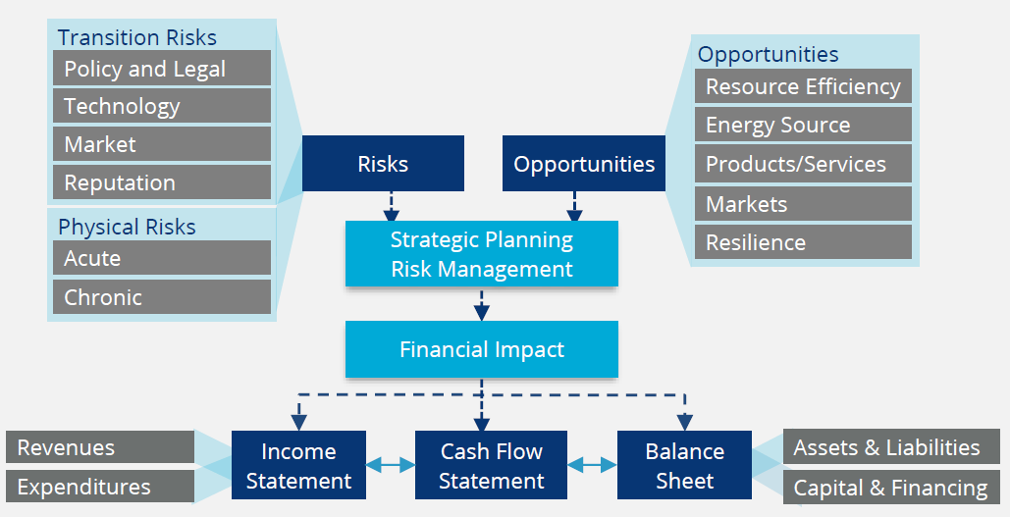
Mandatory climate disclosure IFRS S2 / AASB S2
Climate-Related Risks, Opportunities, and Financial Impact (TCFD, 2017, p.8)

Slide 26
GHG Accounting and Climate Reporting
Carbon accounting
GHG Accounting systems:
Scope 1, 2 and 3 GHG emissions
Carbon footprint
Metrics and Targets
GHG reporting
GHG inventory

Slide 27

GHG Accounting and Climate Reporting
Gold standard:
Greenhouse Gas Protocol-
launched by the World Resources Institute (WRI) and the World Business Council on Sustainable Development (WBCSD) in 1998
GHG (or carbon) accounting
*****GHG Protocol*****
(global standard – referred to in IFRS S2, ISO 14001, CDP, ESRS, GRI)
Currently being updated – hasn’t been updated for a long time!
https://money.com/what-is-the-gold-standard/

Slide 28

GHG Accounting and Climate Reporting
The GHG Protocol deals with seven significant GHGs which are listed in the Kyoto Protocol and tracked by the Paris Agreement.
Each of the gases impacts global warming to a different extent, which is measured by the gas’ global warming potential (GWP) i.e. a measure of how much a GHG contributes to global warming relative to carbon dioxide (CO2).
Global warming potential (GWP) values for 100-year time horizon (IPCC Sixth Assessment Report, 2020) (AR6)
GHG | GWP value
carbon dioxide (CO₂) | 1
methane (CH₄) | 27
nitrous oxide (N₂O) | 273
hydrofluorocarbons (HFCs) HCF-143 and HCF-143A | 364; 5,810
perfluorocarbons (PFCs) – PFC-116 | 12,400
nitrogen trifluoride (NF₃) | 17,400
sulfur hexafluoride (SF₆) | 24,300
https://www.sweep.net/blog/understanding-carbon-dioxide-equivalent-co2e

Slide 29
Estimating GHG emissions - systems
General rule for computing the CO2-e is as follows:
Activity data x appropriate published emission factor = Amount of GHG (e.g. CH4)
Then to standardise:
Amount of GHG (e.g. CH4) x appropriate GWP factor* (e.g. GWP for CH4) = CO2-e
*GWP – global warming potential

Slide 30
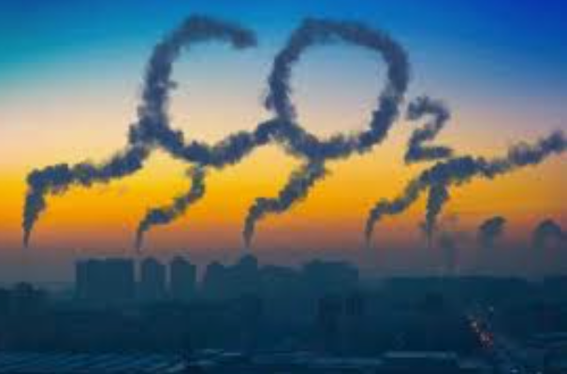
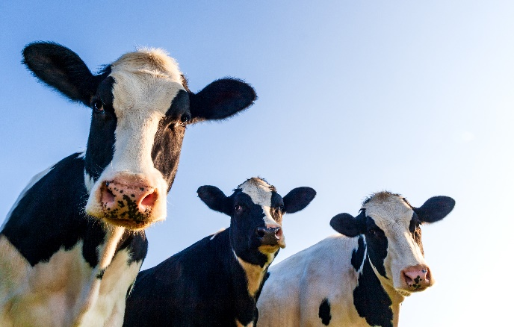
GHG Accounting and Climate Reporting
Greenhouse Gases:
Carbon Dioxide (CO₂) levels are increased by activities such as burning fossil fuels (e.g. coal, oil and natural gas).
Methane (CH₄) is emitted from agriculture (like livestock), natural gas production, and decomposition of waste.
Nitrous Oxide (N₂O) levels are increased by activities such as fertilisers used in agriculture.
Hydrofluorocarbons (HFCs) are used for example in refrigeration, air conditioners and aerosols.
Perfluorocarbons (PFCs) are used in electronics and other industrial processes, such as production of aluminium.
Sulfur Hexafluoride (SF₆) is used in electrical equipment and can leak into the atmosphere.
Nitrogen Trifluoride (NF₃) is used in the manufacturing of semiconductors.
https://geographical.co.uk/climate-change/geo-explainer-how-carbon-emissions-affect-climate

Slide 31

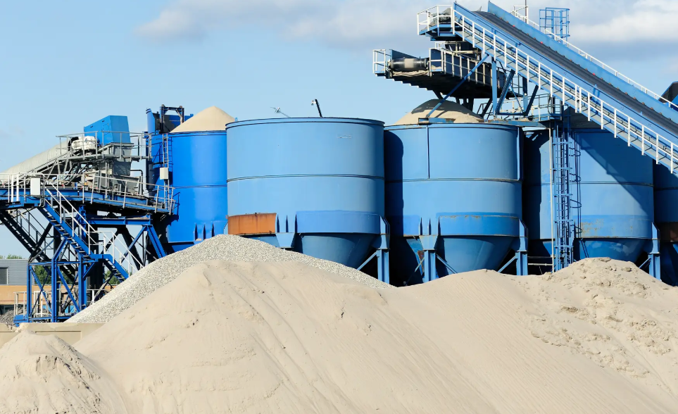
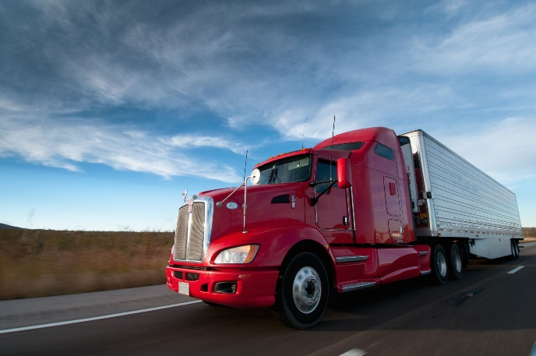
GHG Accounting and Climate Reporting
Examples of industries that have high GHG emissions which are hard to abate (reduce):
Steel production
Cement manufacturing
Chemicals and petrochemicals (including plastics and fertilizers)
Aviation
Shipping (maritime transport)
Heavy-duty road transport (trucking)
Aluminium production
Oil and gas refining
Forestry, Agriculture, and Land Use (FLAG)
Power generation (if reliant on fossil fuels)
Mining
https://www.bigrentz.com/blog/how-is-cement-made?srsltid=AfmBOop5UJYaKuO8QGfHA9292AK0bHeIAHaO9kmuffDiBX98Gz3cNMsz

Slide 32
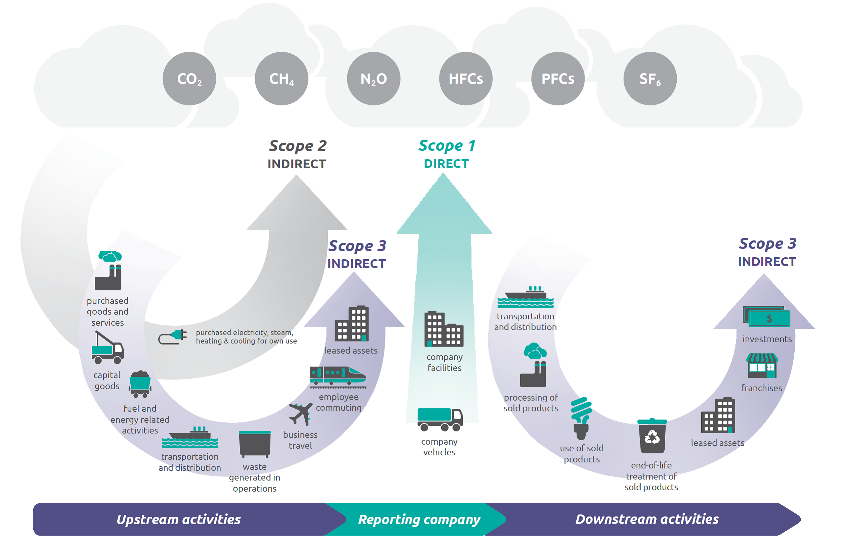
Some are saying: Climate first; not climate only!
BBB
Scope 1,2, and 3 GHG emissions
Burn
Buy
Beyond!
https://www.sustain.life/
https://ghgprotocol.org/sites/default/files/standards/Corporate-Value-Chain-Accounting-Reporing-Standard_041613_2.pdf

Slide 33
SCOPE 3 emissions from the GHG protocol
Upstream scope 3 emissions
Category 1 Purchased goods and services
Category 2 Capital goods
Category 3 Fuel and energy related activities (not included in scope 1 or scope 2)
Category 4 Upstream transportation and distribution
Category 5 Waste generated in operations
Category 6 Business travel
Category 7 Employee commuting
Category 8 Upstream leased assets
Downstream scope 3 emissions
Category 9 Downstream transportation and distribution
Category 10 Processing of sold products
Category 11 Use of sold products
Category 12 End of life treatment of sold products
Category 13 Downstream leased assets
Category 14 Franchises
Category 15 Investments
Can be tricky and costly
Supply chain management

Slide 34
What scope of emissions is it anyway?
Emissions from manufacturing processes such as cement, aluminium and ammonia production.
Scope 1
2) Emissions from transportation of employees in company owned vehicles.
Scope 1 (fuel use)
3) Emissions from the waste disposal and treatment of products sold by the reporting company (in the reporting year) at the end of their life.
Scope 3 Category 12
4) Purchase of electricity to use in the factory.
Scope 2

Slide 35
What scope of emissions is it anyway?
5) Life-time emissions from the use of goods sold by Co A in the reporting year.
Scope 3 Category 11
6) Emissions from fuel burnt in company owned car.
Scope 1
7) Emissions from fuel burnt in employee’s car on the way to and from work.
Scope 3 Category 7
8) Emissions from the fuel burnt in a taxi in London used by an employee when attending a work conference.
Scope 3 Category 6

Slide 36
WALKING THE TALK – REPORTING VERSUS PRACTICE
ESG Reporting
Meaningful metrics / info
Attainable targets
ESG Practices
Strategy
Business models
Risk appetite
Risks / opportunities
Systems
Laws / Regulations

Slide 37


A few considerations…
Nobody can know everything about sustainability –
we need multidisciplinary teams and collaboration
‘Progress over perfection’
Waiting for perfect data versus ‘doing the right thing’ NOW
Many are finding the changes challenging (even the
bigger end of town) – you are not alone!
Trade-offs and balance
Celebrate the (small) wins
Look out for ‘low hanging fruit’
Managing most meaningful impacts
‘Rome wasn’t built in a day’
https://www.thebalancemoney.com/beware-the-lure-of-low-hanging-fruit-in-business-2276088
https://www.britannica.com/place/ancient-Rome

Slide 38
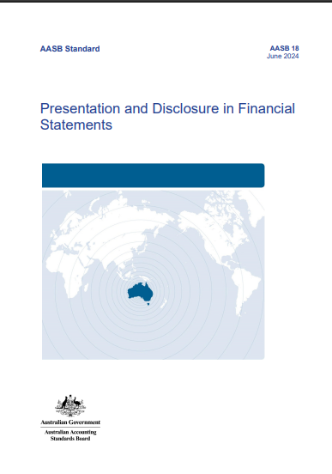
IFRS / AASB 18 Presentation and Disclosure in Financial Statements
Accounting Standards Update:
IFRS/AASB 18 Presentation and Disclosure in Financial
Statements
The income statement format is changing!!!

Slide 39
IFRS / AASB 18 Presentation and Disclosure in Financial Statements
AASB 18 replaces AASB 101 Presentation of Financial Statements.
AASB 18 effective for annual periods beginning on or after 1 January 2027.
The aim of AASB 18 is to improve transparency and comparability of financial performance.
Many investors use sub-totals in the Statement of profit or loss as the start of their analysis, yet some of these sub-totals were defined differently by various entities.

Slide 40
IFRS / AASB 18 Presentation and Disclosure in Financial Statements
Many requirements and disclosures contained in AASB 101 remain unchanged in the new AASB 18 or in other standards.
Some requirements from AASB101 / IAS 1 have been inserted into a revised version of AASB 108 / IAS 8, which has been retitled ‘Basis for Preparation of Financial Statements’ (previously named ‘Accounting Policies, Changes in Accounting Estimates and Errors’).
AASB 18 is accompanied by limited amendments to the requirements of other standards, such as AASB 107 Statement of Cash Flows.
Changes to cash flow statements!

Slide 41
IFRS / AASB 18 Presentation and Disclosure in Financial Statements
Key changes arising from AASB 18:
Statement of profit or loss format changes
New management-defined performance measures (MPMs) note
Consequential changes to statement of cash flows

Slide 42
IFRS / AASB 18 Presentation and Disclosure in Financial Statements
Key changes arising from AASB 18:
1) Statement of profit or loss
• Income and expenses must be classified in the statement of profit or loss into one of five categories – investing, financing, income taxes, discontinued operations and operating
• Two new mandatory subtotals must be shown on the face of the statement – ‘operating profit or loss’, and ‘profit or loss before financing and income taxes’
• Rules for labelling, aggregation and disaggregation of items in the financial statements

Slide 43
 | $ | Classification
Revenue | 10 000 | Operating
Cost of sales | (6 000) | Operating
Gross profit | 4 000 | Operating | Sub-total not mandated, but allowed.
Other operating income | 500 | Operating
Selling expenses | (300) | Operating
Research and development expenses | (200) | Operating
General and admin expenses | (900) | Operating
Other operating expenses | (100) | Operating
Operating profit | 3 000 |  | New mandatory sub-total.
Share of profit from associates | 500 | Investing
Profit before financing and income tax | 3 500 |  | New mandatory sub-total.
Interest expense | (200) | Financing
Profit before income taxes | 3 300 |  | Sub-total already required.
Income tax expense | (1 000) | Income tax
Profit from continuing operations | 2 300 |  | Sub-total already required.
Loss from discontinued operations | (100) | Discont ops
Profit | 2 200 |  | Total already required.

Slide 44
IFRS / AASB 18 Presentation and Disclosure in Financial Statements
Operating category
residual category of income and expenses not classified into any of the other categories.
includes all income and expenses arising from a company’s main business activities.

Slide 45
IFRS / AASB 18 Presentation and Disclosure in Financial Statements
Investing category
income and expenses from stand-alone investments and includes:
  rentals from an investment property,
  dividends from shares in other companies,
  income and expenses from cash and cash equivalents, and
  share of profits from an associate.

Slide 46
IFRS / AASB 18 Presentation and Disclosure in Financial Statements
Financing category
income and expenses relating to how the entity is financed and includes:
  income and expenses from liabilities arising from pure financing transactions (such as on bank loans and bonds) and
  interest income and expenses on all other liabilities that do not only involve the raising of finance (e.g. payables for goods and services and lease liabilities).

Slide 47
IFRS / AASB 18 Presentation and Disclosure in Financial Statements
Income taxes category
Income tax expense (or tax income) that is included in profit or loss.
Discontinued operations category
income and expenses from discontinued operations.

Slide 48
IFRS / AASB 18 Presentation and Disclosure in Financial Statements
Key changes arising from AASB 18:
2) Management-defined performance measures (MPMs) note
What are MPMs?
    sometimes called ‘alternative performance measures’ or ‘non-GAAP measures’
    subtotals of income and expenses that a company uses in public communications outside financial statements to present management’s view of an aspect of the financial performance of the company as a whole, that are not defined by AASB / IFRS Accounting Standards;
New disclosures in a single note to the financial statements about the use of management-defined performance measures, including a reconciliation between the MPM and the closest sub-total in the Statement of Profit or Loss.

Slide 49
IFRS / AASB 18 Presentation and Disclosure in Financial Statements
MPMs cont.
MPMs specifically relate to subtotals of income and expenses (i.e. not to the statement of financial position to statement of cash flows).
some subtotals of income and expenses are not MPMs, such as gross profit, profit before income taxes,‘operating profit or loss before depreciation, amortisation and impairments within the scope of IAS 36’ (OPDAI) is not an MPM.

Slide 50
IFRS / AASB 18 Presentation and Disclosure in Financial Statements
Key changes arising from AASB 18:
3)Statement of cash flows
Amendments to the presentation requirements for interest income and expenses, and dividend income in the statement of cash flows.

Slide 51
IFRS / AASB 18 Presentation and Disclosure in Financial Statements
Consequential amendments to IAS 7 / AASB 107 Statement of Cash Flows.
Indirect method for operating cash flows – starting point is the new mandatory sub-total in the statement of profit or loss – ‘operating profit or loss’ (previously the starting point was ‘profit or loss’). This may be a change for many companies and may change the reconciling items.
Removing the presentation choices related to interest and dividend cash flows.
  Interest cash inflows – classified as investing cash flows (previously companies could choose an accounting policy of operating or investing cash flows)
  Dividend cash inflows – classified as investing cash flows (previously companies could choose an accounting policy of operating or investing cash flows)
  Interest cash outflow – classified as a financing cash flow (previously companies had an accounting policy choice between operating or financing cash flows)
  Dividend cash outflow - classified as a financing cash flow (previously companies had an accounting policy choice between operating or financing cash flows)

Slide 52
BEWA Conference 2025, Ambrose Estate, Wembley Downs
29 August 2025
AGENDA
Sustainability Standards Update: IFRS/AASB S2 Climate-related Disclosures
Accounting Standards Update: IFRS/AASB 18 Presentation and Disclosure in Financial
Statements
Thank you!

