Slide 1

BEWA ACCOUNTING PRESENTATION
Gavin crosthwaite
GAVIN.CROSTHWAITE@EDUCATION.WA.EDU.AU

Slide 2


Slide 3
ACCOUNTING CARDS
Account Type | Debit | Credit
Asset
Liability
Equity
Income
Expense

Slide 4
Accounting books - DOYLE
Accounting books
What works well for me | Even better if…
Good introductory explanations Questions start from bare basics Questions have good progression Good starting questions in a new topic | Solutions are not correct in the book The range of questions are not a lot different Not a lot of open ended theory or multiple choice questions

Slide 5
Accounting books - COVNEY
Accounting books
What works well for me | Even better if…..
Good introductory explanations The questions progress in a good linear fashion Expected solutions are in the bottom of the question for some topics There are a good range of open-ended theory questions. The steps to complete questions are well laid out Exam tips are given to students | Solutions are not at the end for all topics The range of questions are not a lot different Still a few errors in the book (although being updated regularly) The number of higher end questions are less than other publications

Slide 6
Accounting books – NELSON ACCOUNTING AND FINANCE
Accounting books
What works well for me | Even better if…..
Extremely thorough, particularly in theory Good range of questions including higher range questions for stronger students Does have case studies which show real world application | No expected solution at the end of the question The theory is a bit out of date now and hasn’t been updated for a number of years Very wordy and dense which my students struggle with

Slide 7
Accounting books – CRIDDLE
Accounting books
What works well for me | Even better if…..
Good introductory explanation of theory concepts with concrete examples Has a summary of terms at end of the chapter Good range of theory questions | The books I have are older and no GST included in transactions. (not sure if it has been updated) The range of questions are not a lot different. The demonstrations are not as clearly laid out as other books.

Slide 8


Slide 9
Week 1 – Lesson 1 Question
A company purchased a truck for $25,000 on January 1, 2020 and is expected to have a residual value of $5,000. The truck is estimated to have a useful life of 5 years, and straight-line depreciation is used. What are the depreciation and accumulated depreciation values recorded for the year ended 30th June 2020, 2021 and 2022?

Slide 10
Week 8 – Lesson 2 Question
Pyramid Company expects to incur $3,000,000 in manufacturing overhead costs this year.
During the year, it expects to use 40,000 direct labor hours at a cost of $600,000 and 80,000 machine hours.
Required:
Prepare a predetermined overhead rate based on direct labor hours and machine hours.
Why might Pyramid Company prefer to use machine hours to allocate manufacturing overhead?
Using each of the predetermined overhead rates calculated in part a and the data that follows for job 128, determine the cost of job 128.
Direct materials | $6,000
Direct labor | (200 hours at $15 per hour) + (100 hours at $10 per hour)
Machine time | 700 hours

Slide 11

Mini white boards

Slide 12
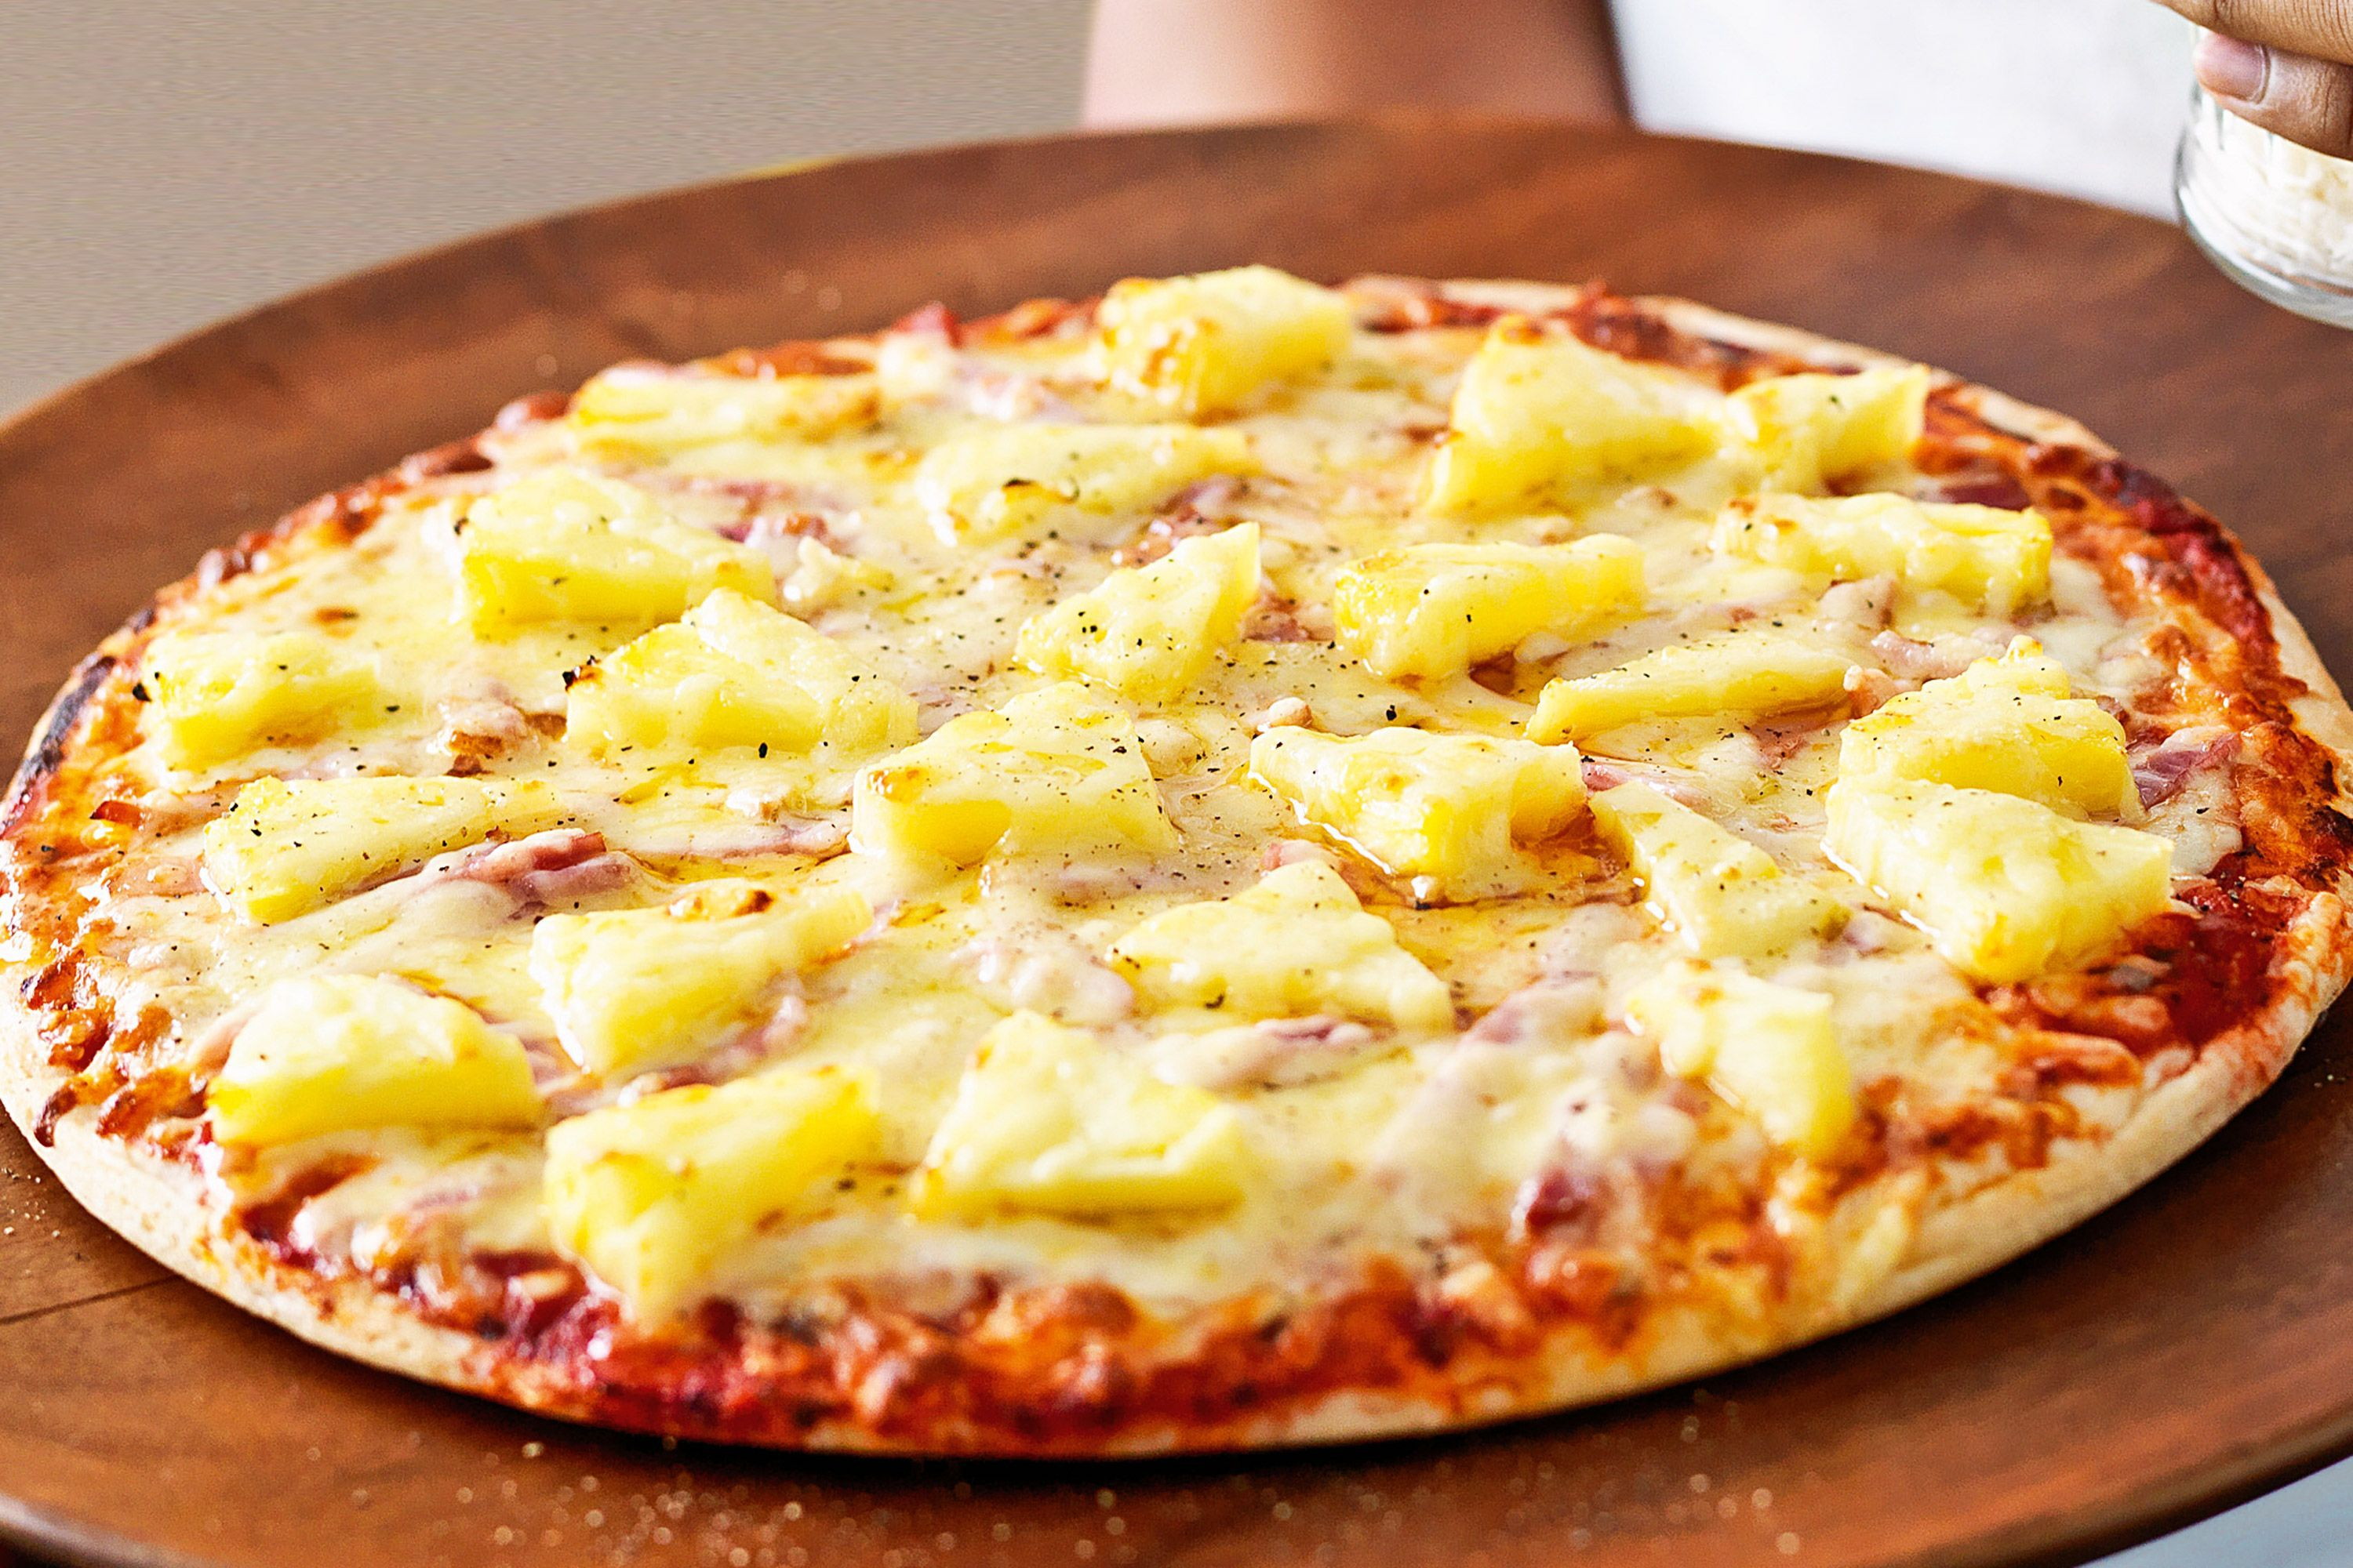

Slide 13
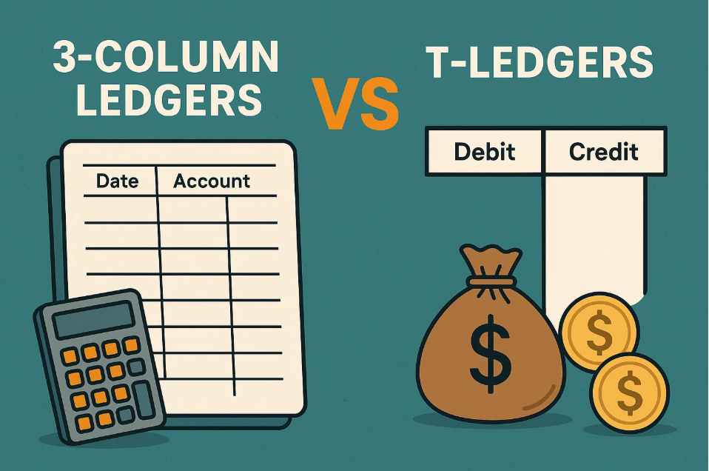

Slide 14

SPOTIFY PODCAST – RENAE GUTHRIDGE

Slide 15
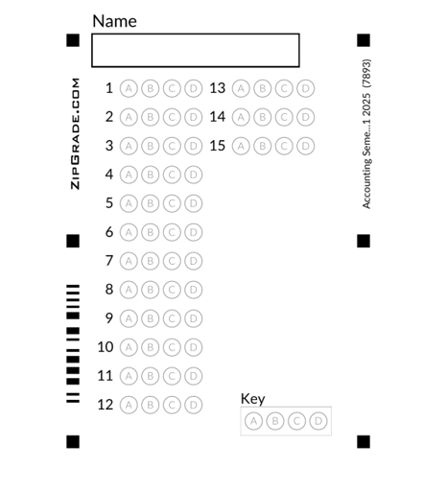
ZIPGRADE

Slide 16
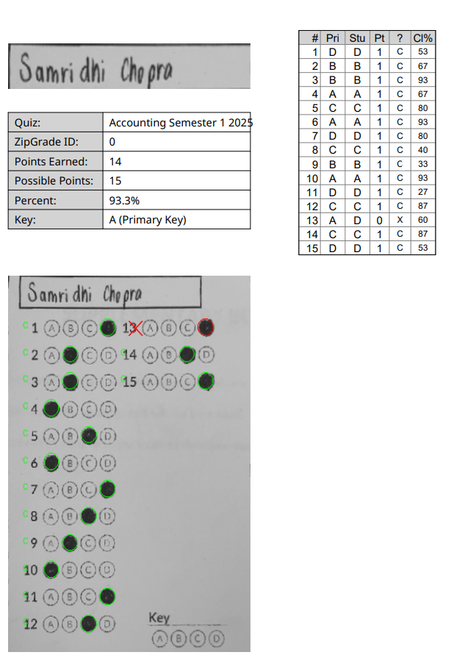
ZIPGRADE

Slide 17
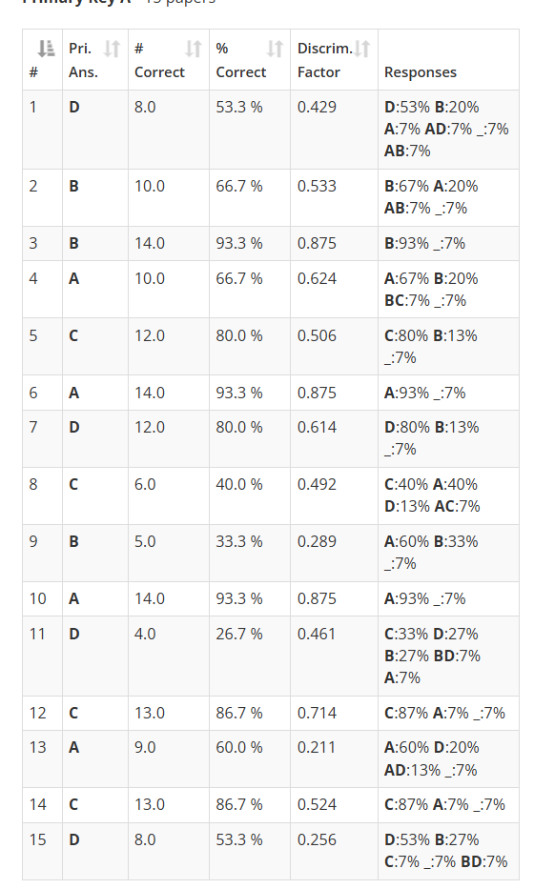
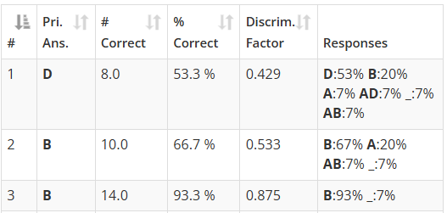

Slide 18

Homework

Slide 19

Practice Tests

Slide 20


Slide 21
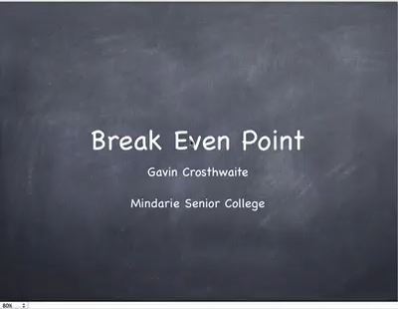
Video tutorials

Slide 22
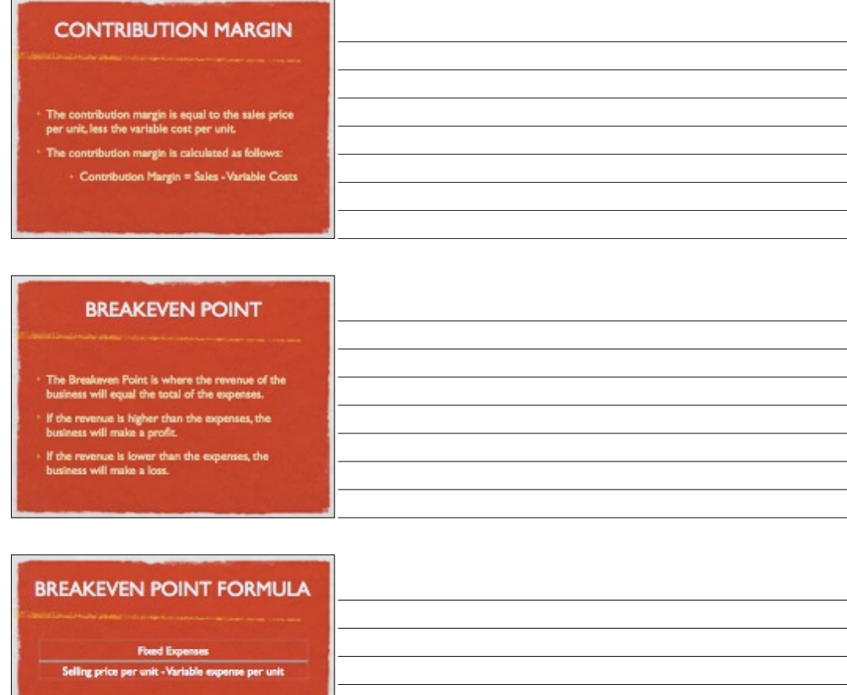
Exam revision sessions

Slide 23


Slide 24
Komplete Laundry Services provides commercial laundry services to hospitality businesses and health organisations. It is expected that charges for water and power will increase in the future and the company has decided to investigate the acquisition of greener laundry plant and equipment.
Komplete Laundry Services have identified two mutually-exclusive potential suppliers of integrated, solar-powered, water-efficient plant and equipment that it can have installed on 1 January 2012. The options offered by the two suppliers (Gascoyne and Kimberley) differ in the cost of purchase and installation, and offer completely different levels of performance for solar power generation and water efficiency.
The following information has been provided by the two suppliers.
Details Gascoyne $ Kimberley $
Initial cost of investment (spent on 1 January 2012) (600,000) (800,000)
Net incremental cash inflows:
• 2012 (assume received 31 December) 240,000 200,000
• 2013 (assume received 31 December) 240,000 250,000
• 2014 (assume received 31 December) 240,000 250,000
• 2015 (assume received 31 December) 240,000 400,000
• 2016 (assume received 31 December) 240,000 500,000
Residual value as at 31 December 2016 Nil Nil
What is the payback period for each option?

Slide 25
Komplete Laundry Services provides commercial laundry services to hospitality businesses and health organisations. It is expected that charges for water and power will increase in the future and the company has decided to investigate the acquisition of greener laundry plant and equipment.
Komplete Laundry Services have identified two mutually-exclusive potential suppliers of integrated, solar-powered, water-efficient plant and equipment that it can have installed on 1 January 2012. The options offered by the two suppliers (Gascoyne and Kimberley) differ in the cost of purchase and installation, and offer completely different levels of performance for solar power generation and water efficiency.
The following information has been provided by the two suppliers.
Details Gascoyne $ Kimberley $
Initial cost of investment (spent on 1 January 2012) (600,000) (800,000)
Net incremental cash inflows:
• 2012 (assume received 31 December) 240,000 200,000
• 2013 (assume received 31 December) 240,000 250,000
• 2014 (assume received 31 December) 240,000 250,000
• 2015 (assume received 31 December) 240,000 400,000
• 2016 (assume received 31 December) 240,000 500,000
Residual value as at 31 December 2016 Nil Nil
Relevance???

Slide 26
Details Gascoyne $ Kimberley $
Initial cost of investment (spent on 1 January 2012) (600,000) (800,000)
Net incremental cash inflows:
• 2012 (assume received 31 December) 240,000 200,000
• 2013 (assume received 31 December) 240,000 250,000
• 2014 (assume received 31 December) 240,000 250,000
• 2015 (assume received 31 December) 240,000 400,000
• 2016 (assume received 31 December) 240,000 500,000
Residual value as at 31 December 2016 Nil Nil
Look to see if the cash inflows are either the same each year
or differ each year.

Slide 27
Details Gascoyne $ Kimberley $
Initial cost of investment (spent on 1 January 2012) (600,000) (800,000)
Net incremental cash inflows:
• 2012 (assume received 31 December) 240,000 200,000
• 2013 (assume received 31 December) 240,000 250,000
• 2014 (assume received 31 December) 240,000 250,000
• 2015 (assume received 31 December) 240,000 400,000
• 2016 (assume received 31 December) 240,000 500,000
Residual value as at 31 December 2016 Nil Nil
Let’s look at the Gascoyne option which is the same?

Slide 28
Details Gascoyne $ Kimberley $
Initial cost of investment (spent on 1 January 2012) (600,000) (800,000)
Net incremental cash inflows:
• 2012 (assume received 31 December) 240,000 200,000
• 2013 (assume received 31 December) 240,000 250,000
• 2014 (assume received 31 December) 240,000 250,000
• 2015 (assume received 31 December) 240,000 400,000
• 2016 (assume received 31 December) 240,000 500,000
Residual value as at 31 December 2016 Nil Nil
$600,000 (2) /$240,000 (2)
= 2.5 years
= 2 years and 6 months

Slide 29
Details Gascoyne $ Kimberley $
Initial cost of investment (spent on 1 January 2012) (600,000) (800,000)
Net incremental cash inflows:
• 2012 (assume received 31 December) 240,000 200,000
• 2013 (assume received 31 December) 240,000 250,000
• 2014 (assume received 31 December) 240,000 250,000
• 2015 (assume received 31 December) 240,000 400,000
• 2016 (assume received 31 December) 240,000 500,000
Residual value as at 31 December 2016 Nil Nil
Let’s look at the Kimberley option which is not the same?

Slide 30
Details Gascoyne $ Kimberley $
Initial cost of investment (spent on 1 January 2012) (600,000) (800,000)
Net incremental cash inflows:
• 2012 (assume received 31 December) 240,000 200,000
• 2013 (assume received 31 December) 240,000 250,000
• 2014 (assume received 31 December) 240,000 250,000
• 2015 (assume received 31 December) 240,000 400,000
• 2016 (assume received 31 December) 240,000 500,000
Residual value as at 31 December 2016 Nil Nil
z
Details | Opening Balance | Investment Recovered | Closing Balance
Initial Cost |  |  | (800,000)
2012 Cash Inflow | (800,000) | 200,000 | (600,000)
2013 Cash Inflow | (600,000) | 250,000 | (350,000)
2014 Cash Inflow | (350,000) | 250,000 | (100,000)
2015 Cash Inflow | (100,000) | 400,000 | 300,000
Calculation | 100,000/400,000 = .25 therefore 3 years 3 months

Slide 31
Details Gascoyne $ Kimberley $
Initial cost of investment (spent on 1 January 2012) (600,000) (800,000)
Net incremental cash inflows:
• 2012 (assume received 31 December) 240,000 200,000
• 2013 (assume received 31 December) 240,000 250,000
• 2014 (assume received 31 December) 240,000 250,000
• 2015 (assume received 31 December) 240,000 400,000
• 2016 (assume received 31 December) 240,000 500,000
Residual value as at 31 December 2016 Nil Nil
z
Komplete Laundry Services request that you use discounted cash flow analysis to further investigate the investment decision. The net present value of a proposed capital investment project is calculated using the company’s cost of capital of 12%.

Slide 32
Details Gascoyne $ Kimberley $
Initial cost of investment (spent on 1 January 2012) (600,000) (800,000)
Net incremental cash inflows:
• 2012 (assume received 31 December) 240,000 200,000
• 2013 (assume received 31 December) 240,000 250,000
• 2014 (assume received 31 December) 240,000 250,000
• 2015 (assume received 31 December) 240,000 400,000
• 2016 (assume received 31 December) 240,000 500,000
Residual value as at 31 December 2016 Nil Nil
z
. The net present value of a proposed capital investment project is calculated using the company’s cost of capital of 12%.
= ($240,000) (1) (3.6048) (1) - ($600,000) (1)
= $865,152 - $600,000
= $265,152

Slide 33

Multiple Choice Tips
Think the answer is wrong? Maybe you should change it? Studies indicate that when students change their answers they usually change them to the wrong answer. Therefore, if you were fairly certain you were correct the first time, leave the answer as it is.

Slide 34

Multiple Choice Tips
Don't guess too soon! You must select not only a correct answer, but the best answer. It is therefore important that you read all of the options and not stop when you come upon one that seems likely.

Slide 35

Multiple Choice Tips
You must select not only a technically correct answer, but the most completely correct answer. Since "all of the above" and "none of the above" are very inclusive statements, these options, when used, tend to be correct more often than would be predicted by chance alone.

Slide 36
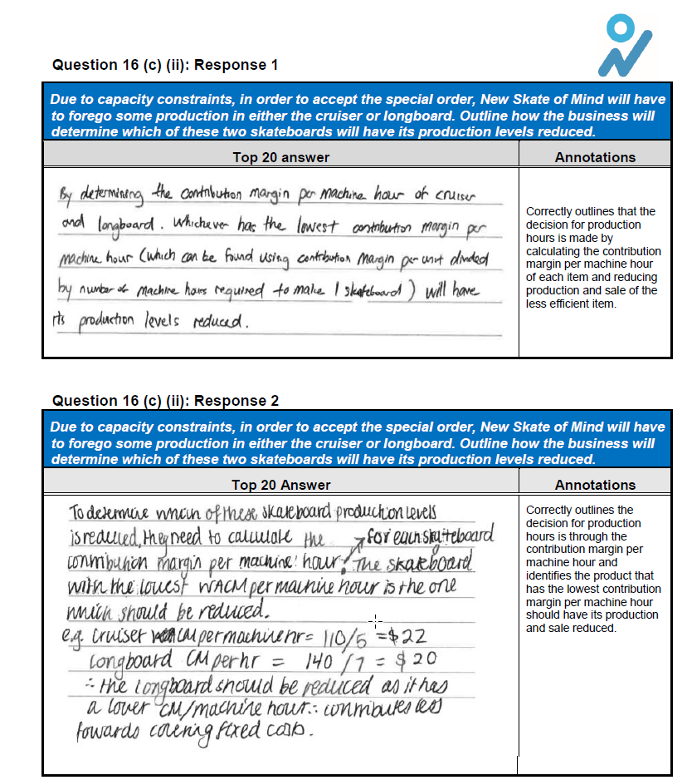
Good answer guide – BEWA/SCSA

Slide 37
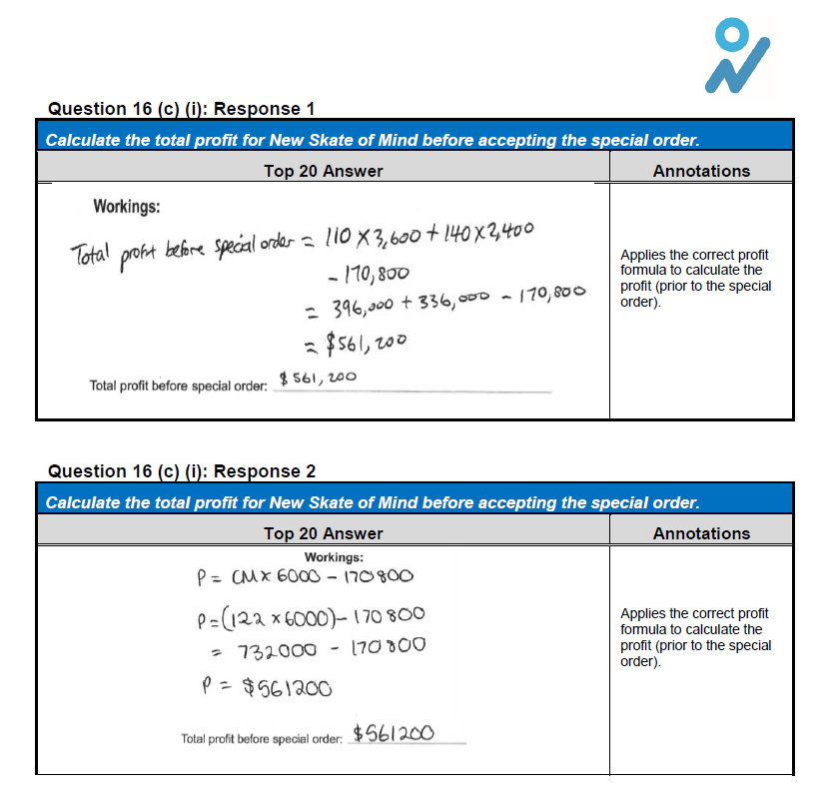
Good answer guide – BEWA/SCSA

Slide 38
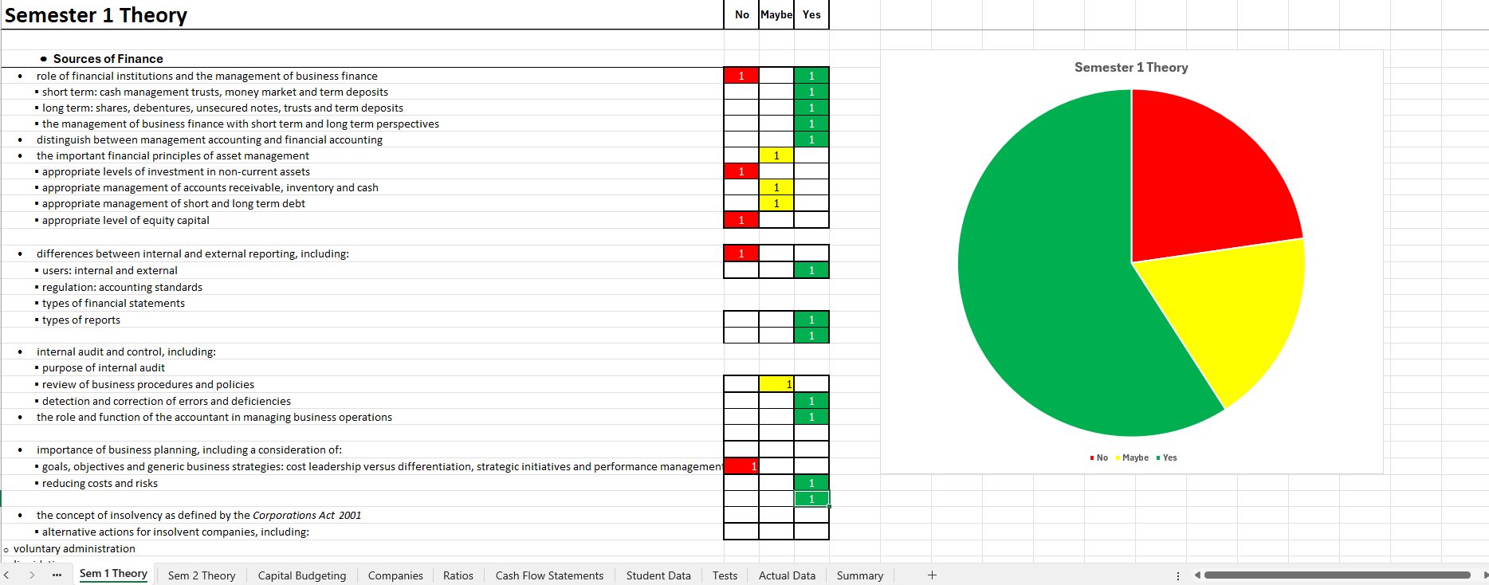
ACCOUNTING TRAFFIC LIGHT SYSTEM

Slide 39
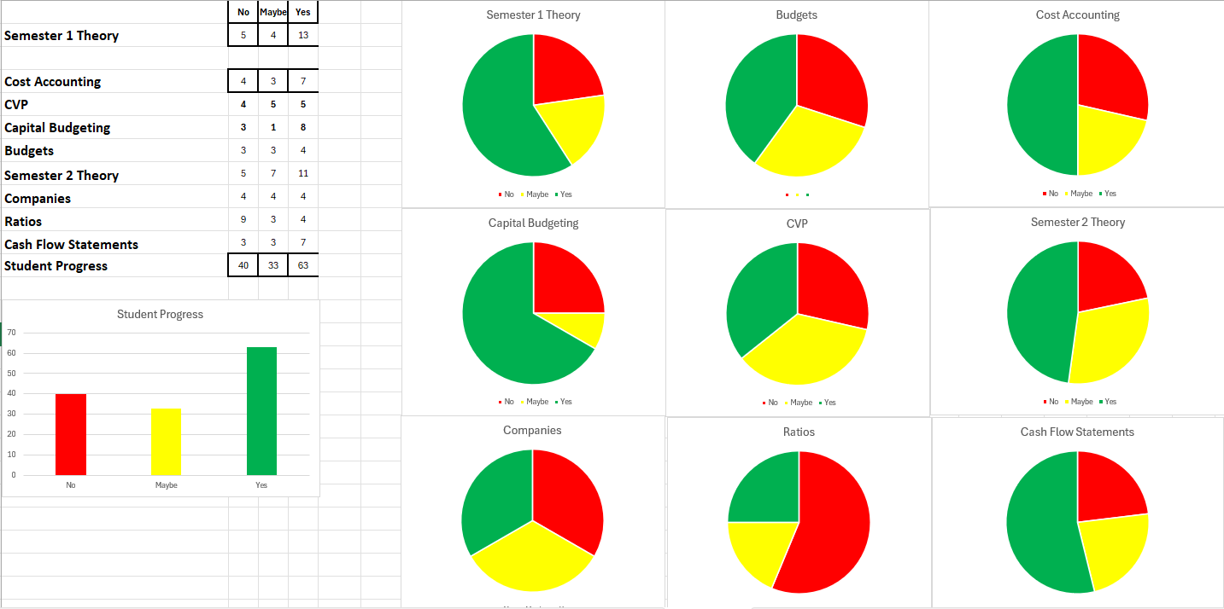
ACCOUNTING TRAFFIC LIGHT SYSTEM

Slide 40
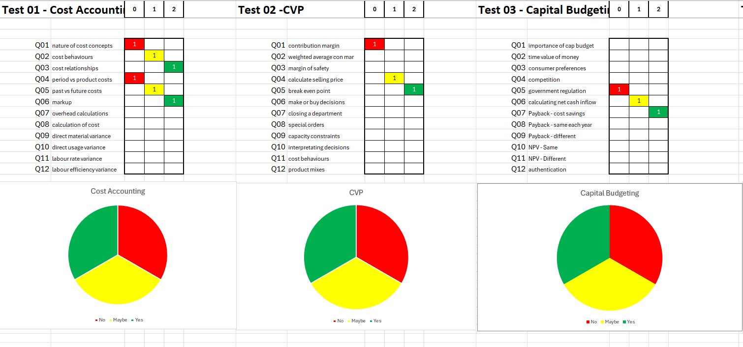

Slide 41
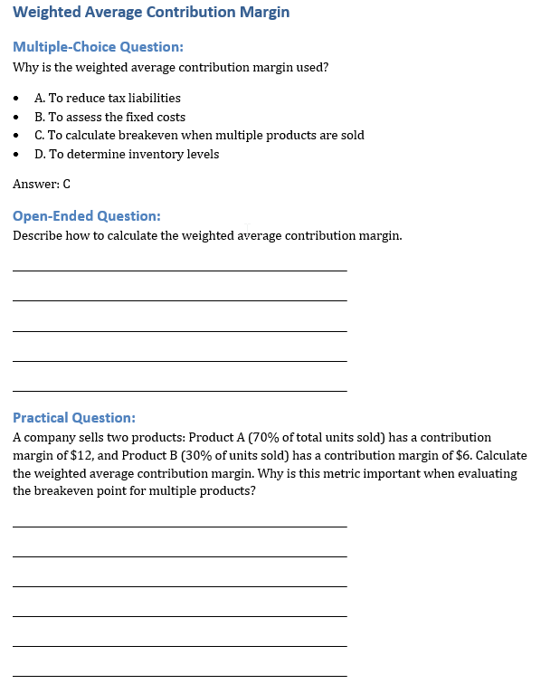


Slide 42
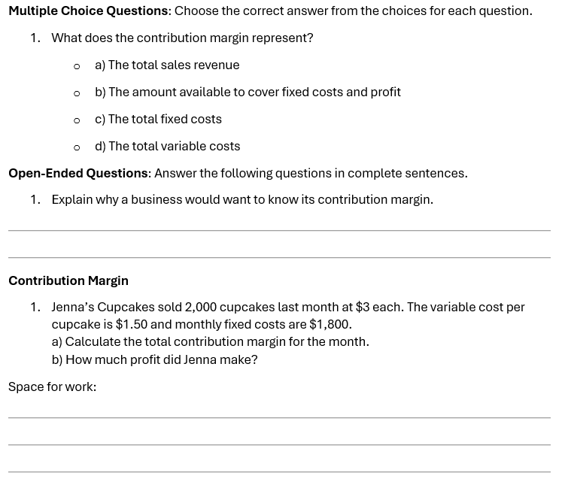
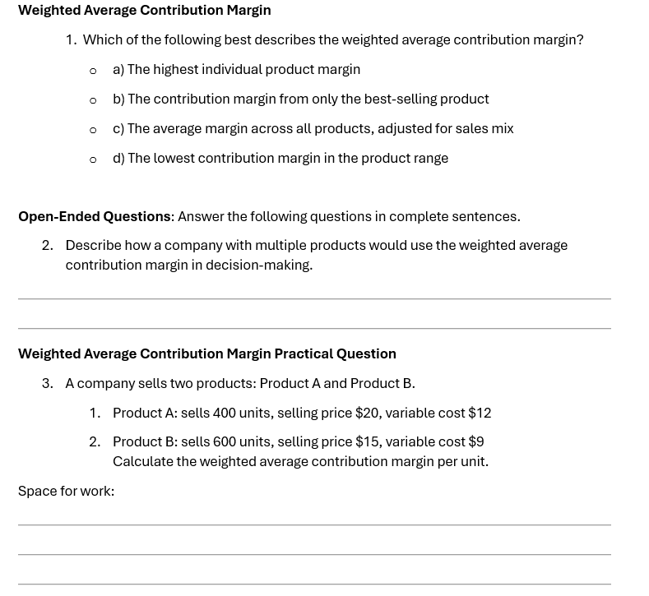

Slide 43
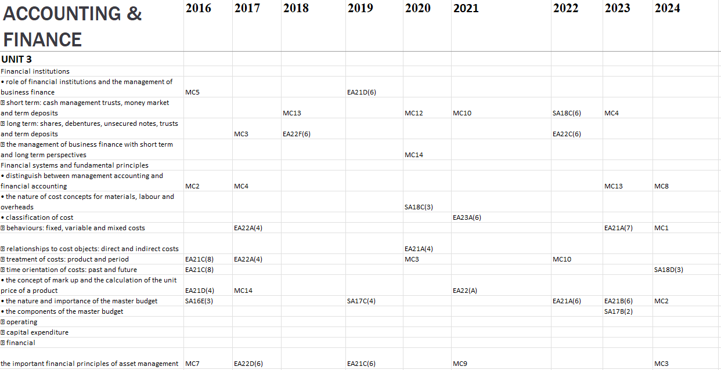
ACCOUNTING SYLLABUS – WACE QUESTIONS

Slide 44
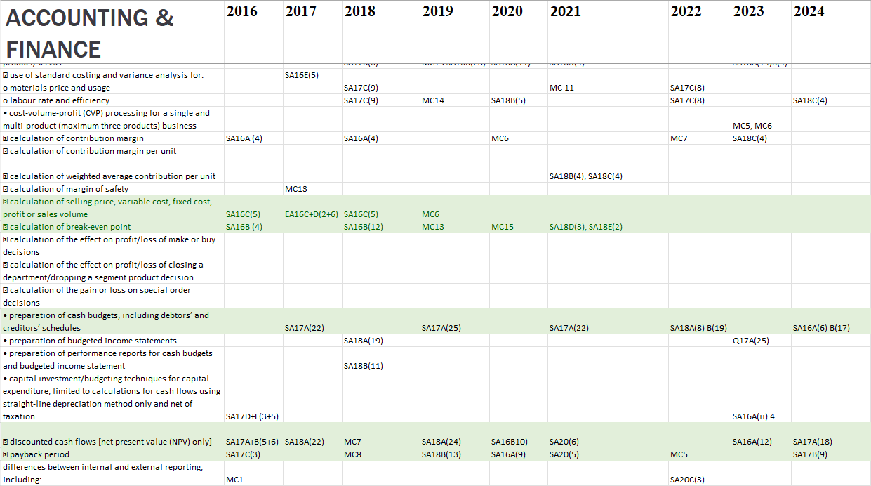
ACCOUNTING SYLLABUS – WACE QUESTIONS

Slide 45


Slide 46

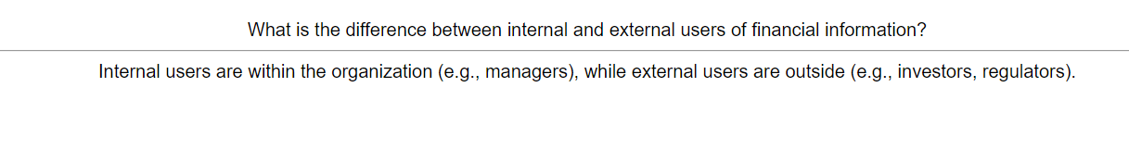
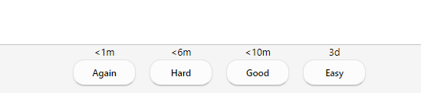
ANKI FLASH CARDS

Slide 47
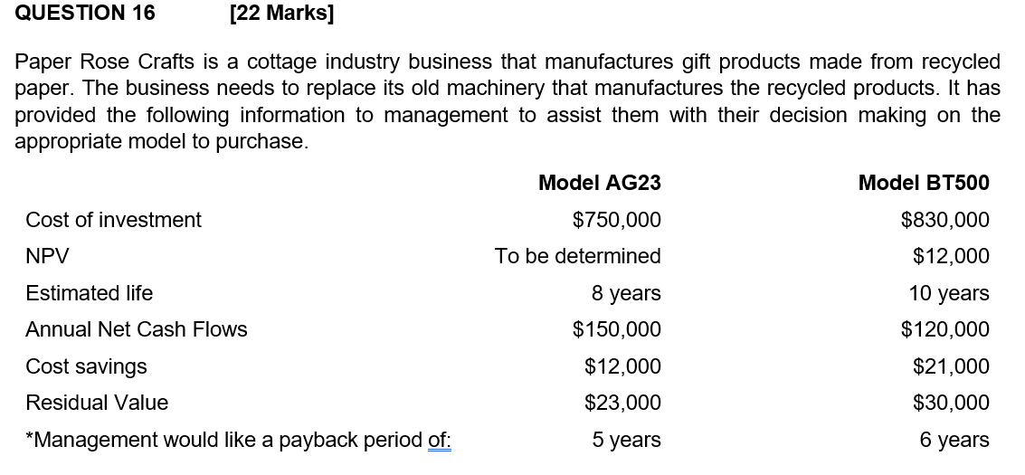
Example BEWA Question

Slide 48
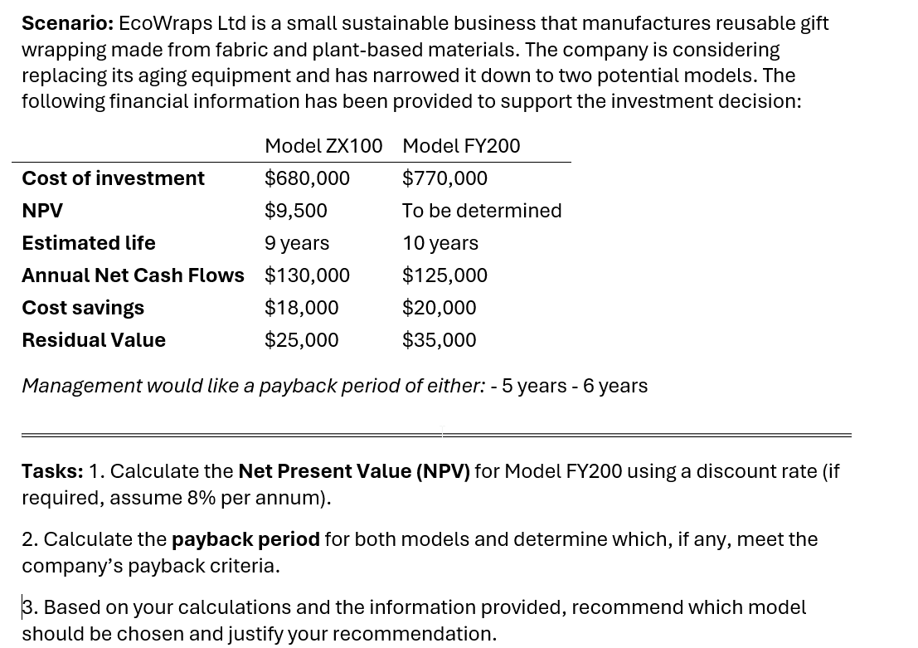
Chat-gpt

Slide 49
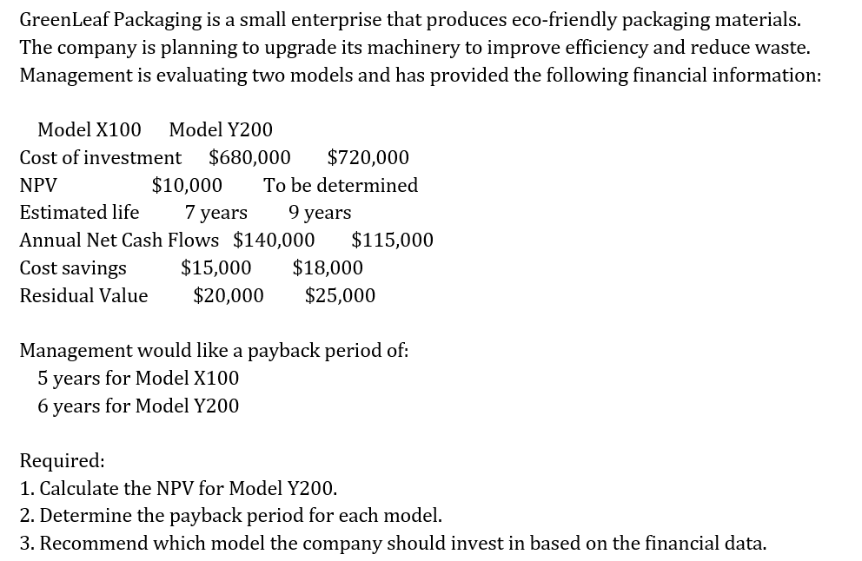
copilot

Slide 50
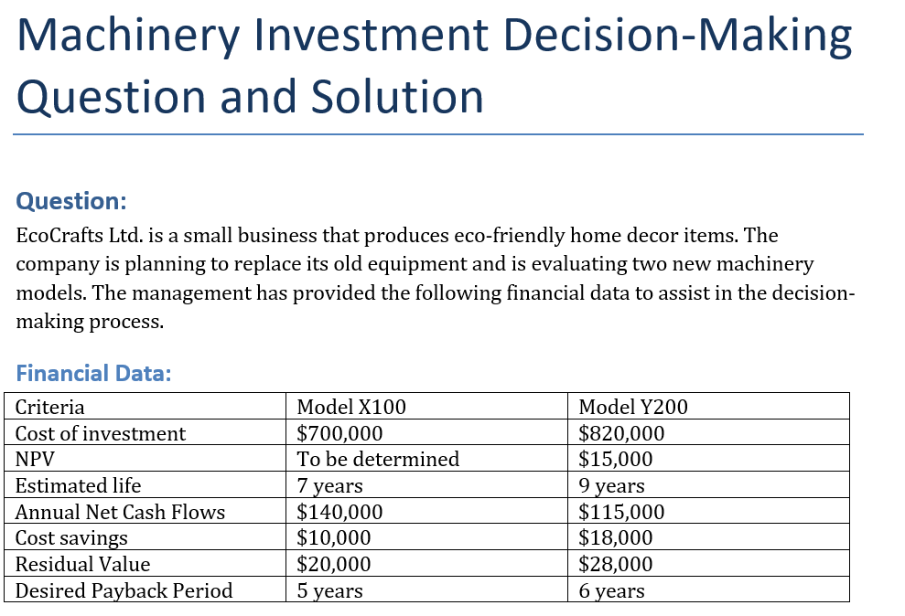
copilot

Slide 51
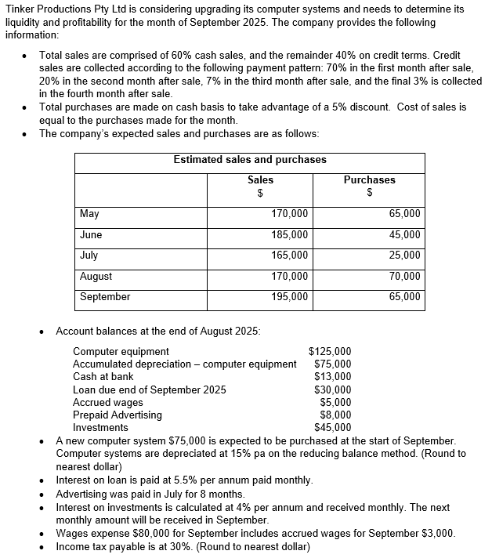
Example BEWA Question

Slide 52
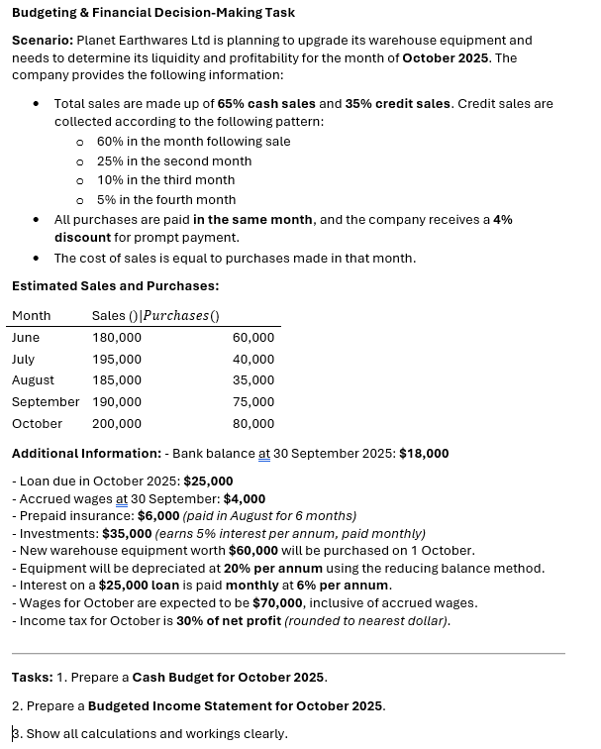
Chat-gpt

Slide 53
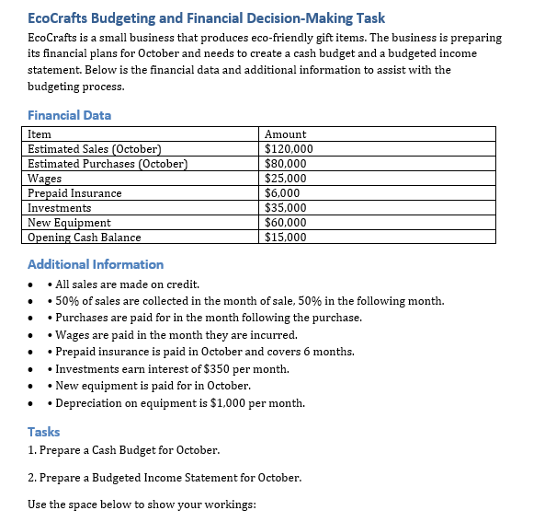
copilot

Slide 54
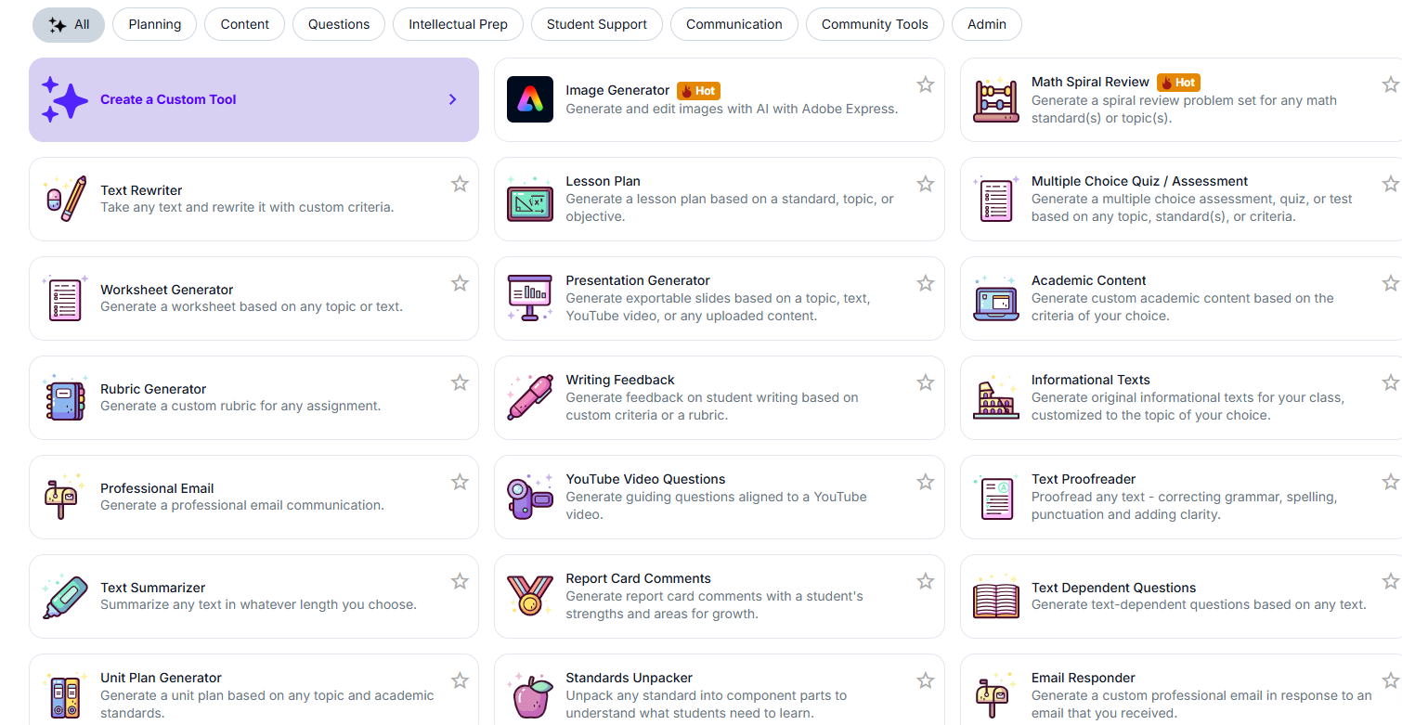
Magic schools

Slide 55


