Slide 1
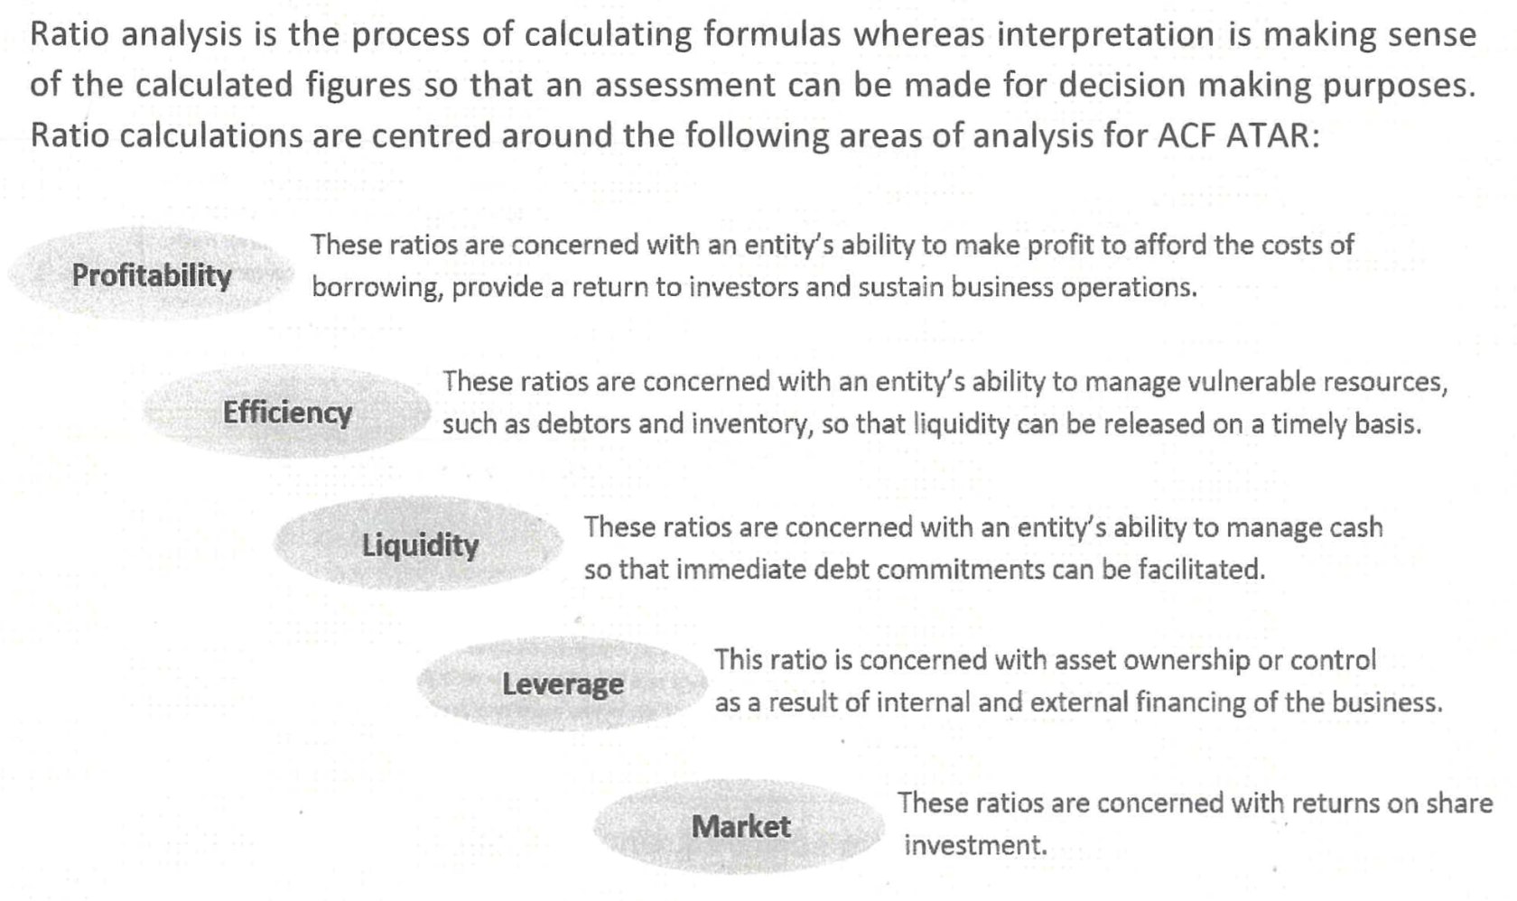
Understanding Ratios

Slide 2
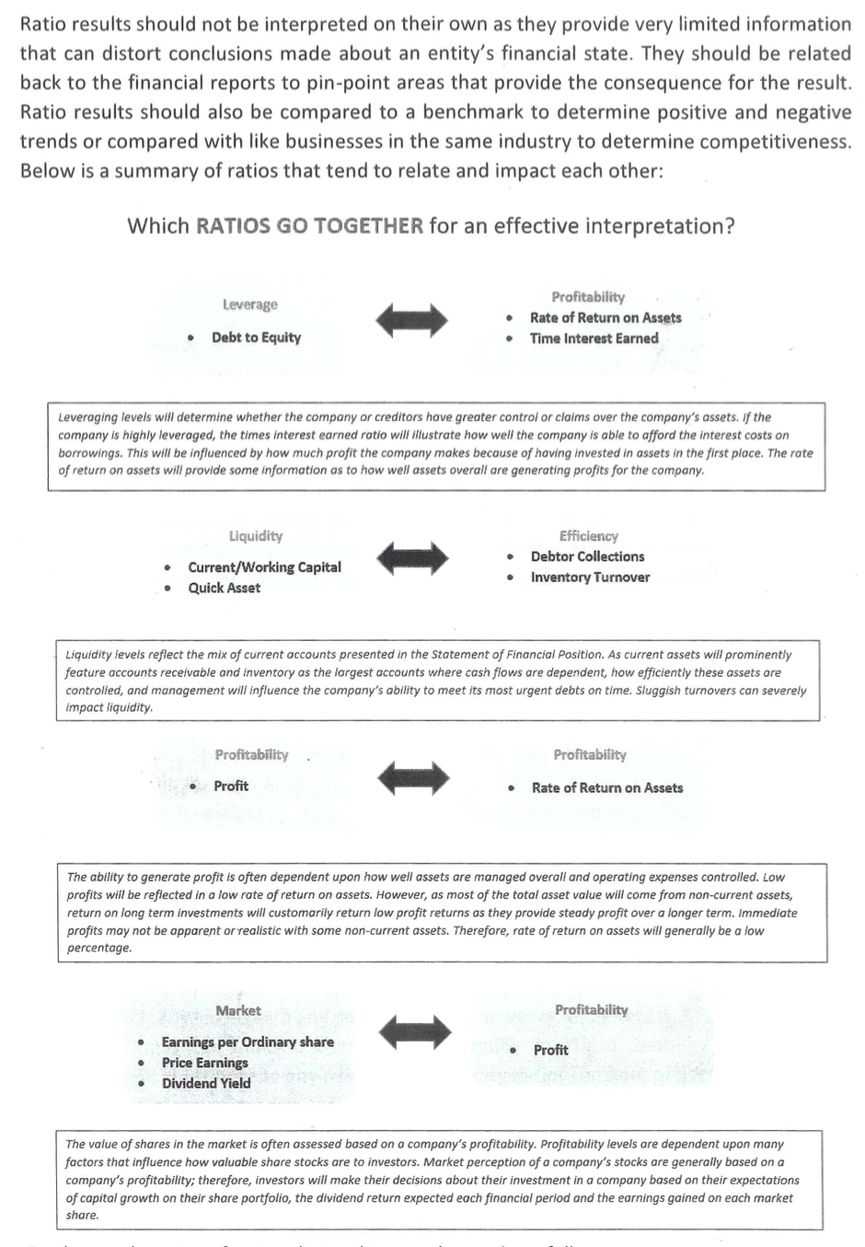
Understanding Ratios

